Slide 1
AIM
C4
Visualising software architecture with C4

Slide 2
Consider the following experiment
Teams of developers were asked to draw pictures given a case study ”Financial Risk System”.
Teams swapped diagrams and reviewed the diagrams answering the following questions:
Does the solution satisfy the architectural dri vers?
If you were the bank, would you buy this solution?
Focus on the diagrams rather than the design: notation, colour coding, symbols, etc

Slide 3
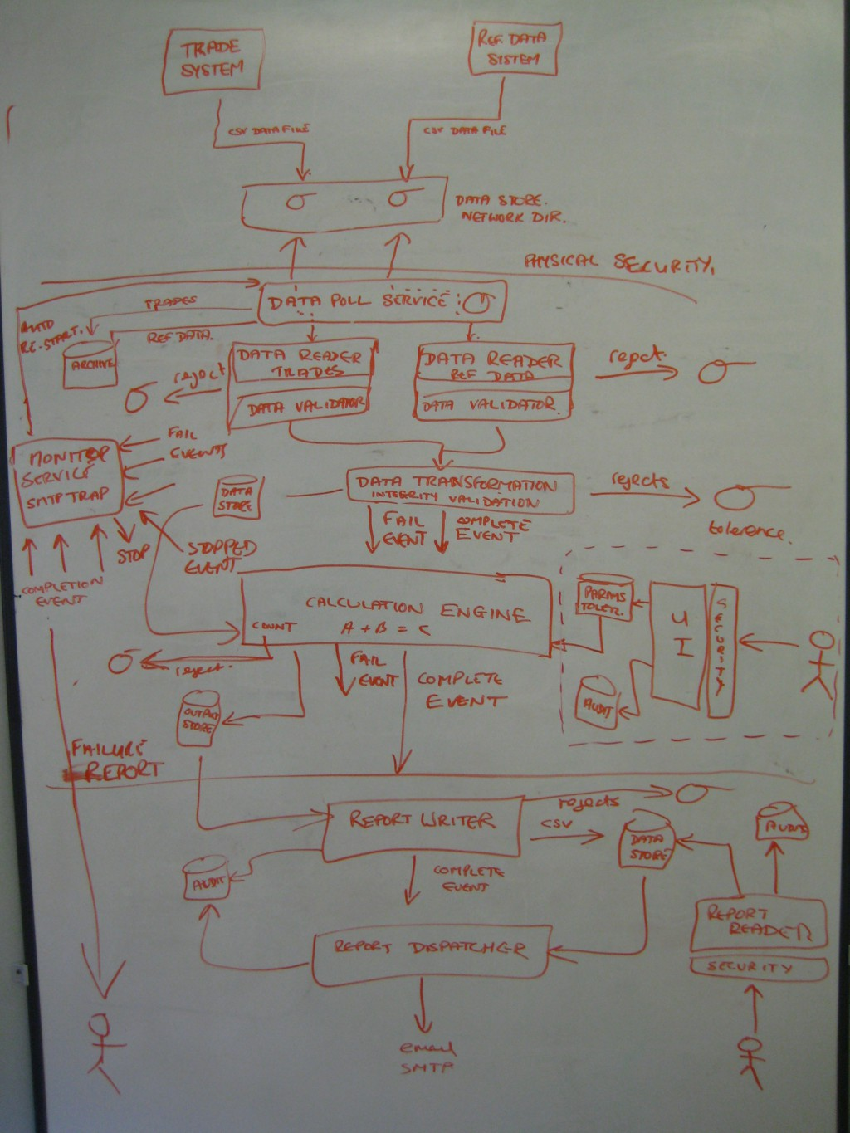
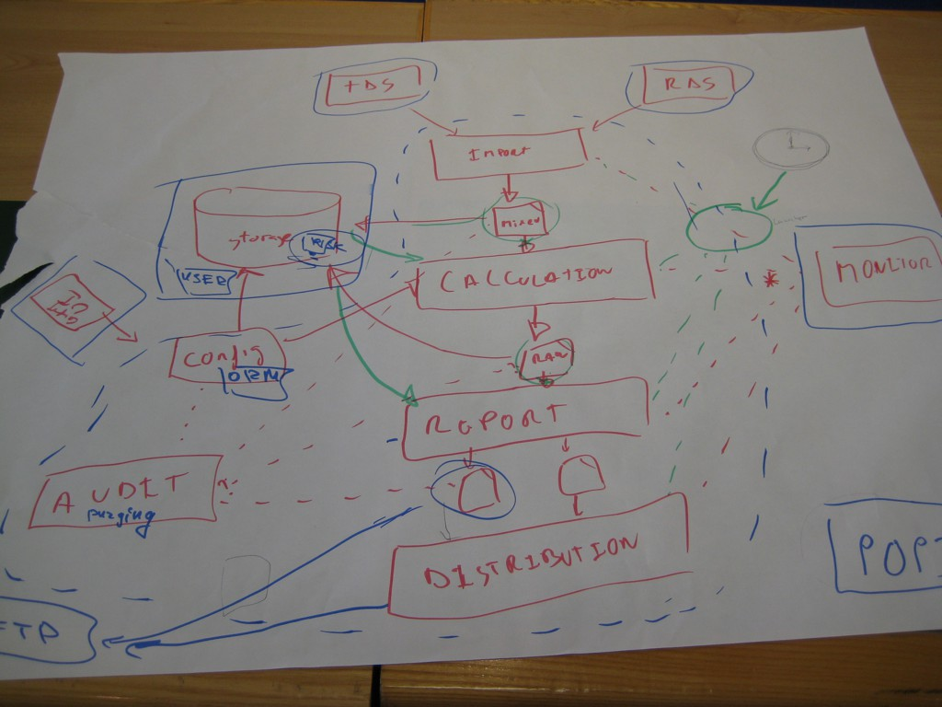
1
1
1
2
2
2

Slide 4
1
1
1
2
2
2

Slide 5



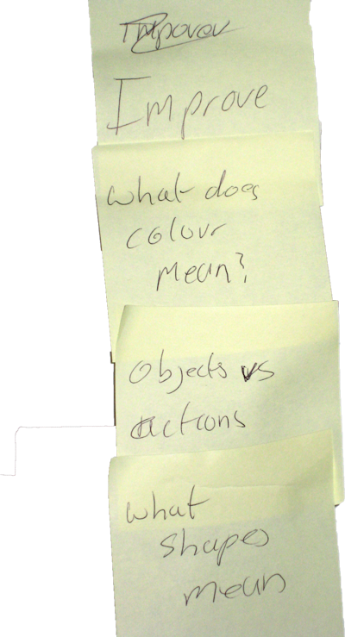
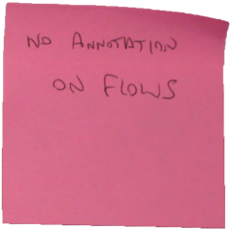
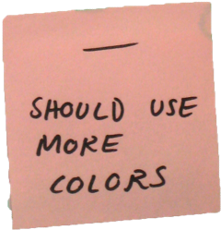

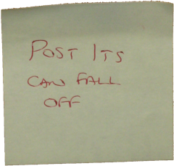

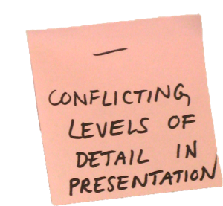

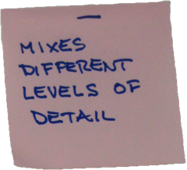

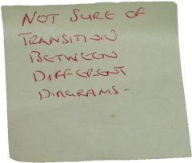

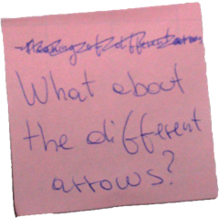


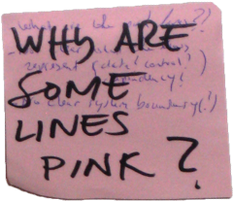


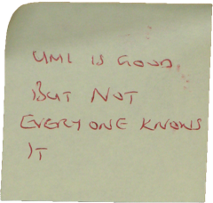

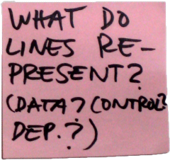



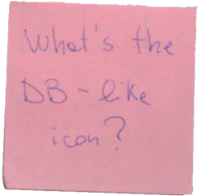

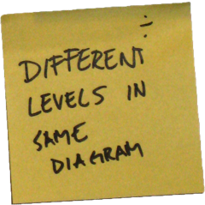

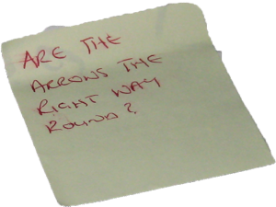
What is this shape/symbol? What is this line/arrow?
•
•
•
•
•
What do the colours mean?
What level of abstraction is shown? Which diagram do we read first?

Slide 6
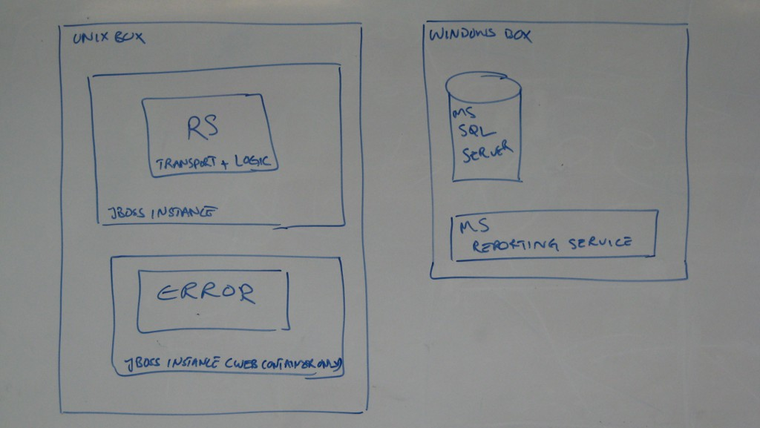

Slide 7
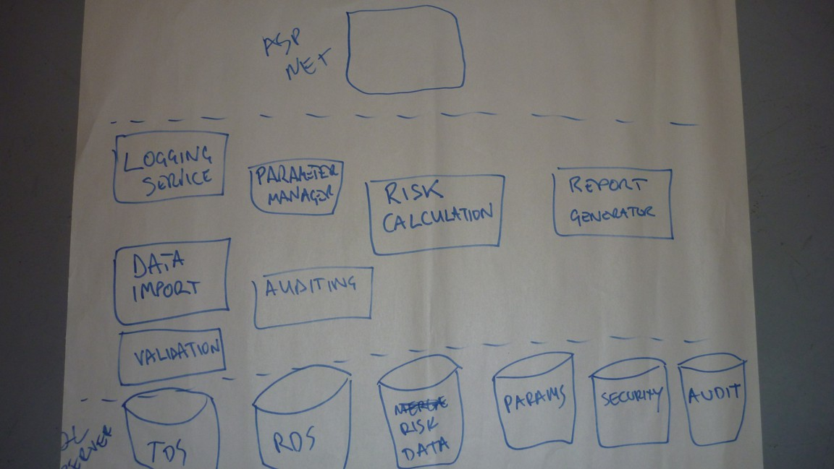

Slide 8
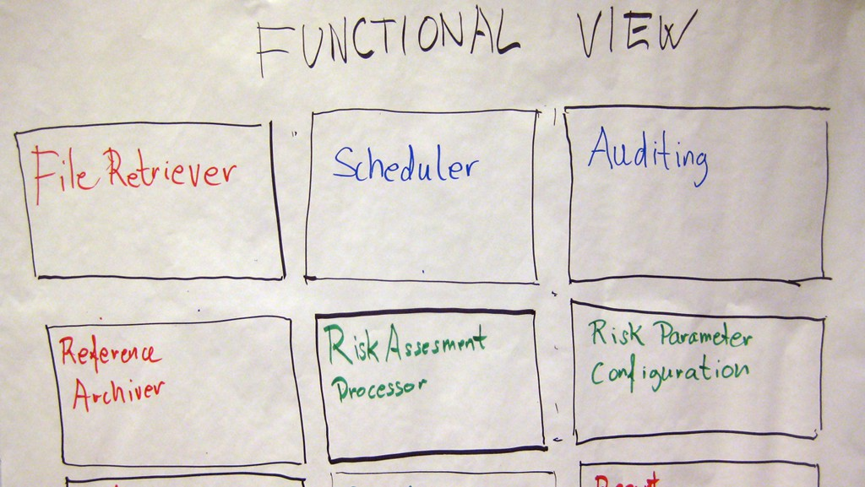

Slide 9
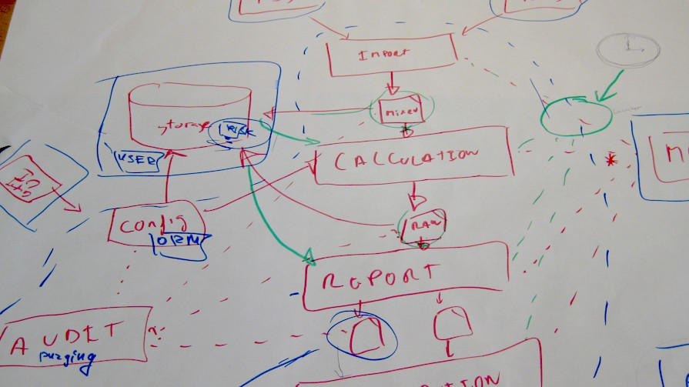

Slide 10
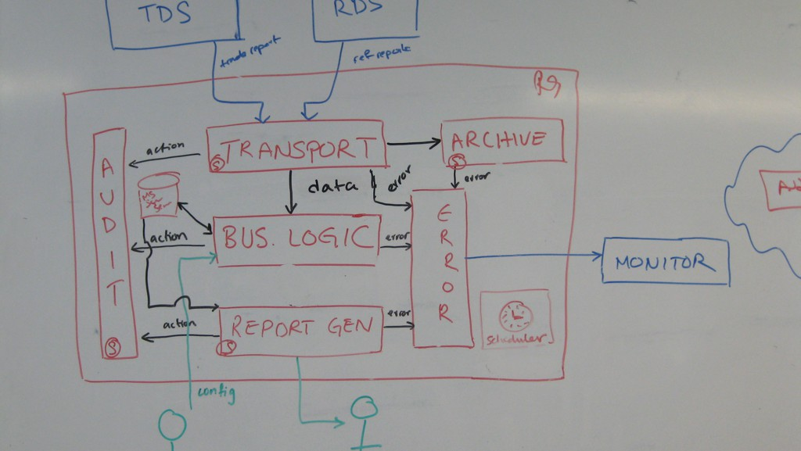

Slide 11
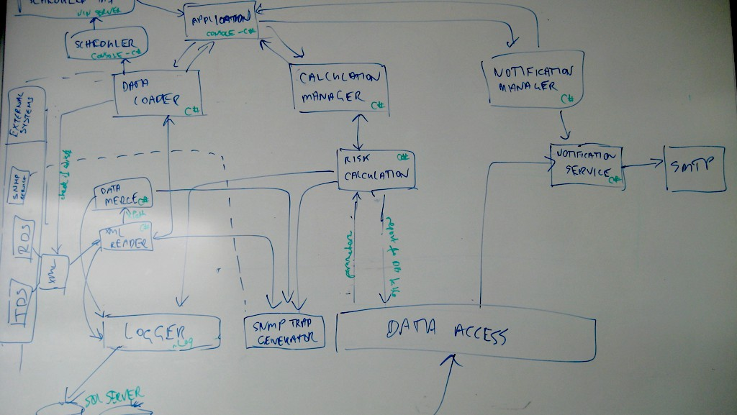

Slide 12
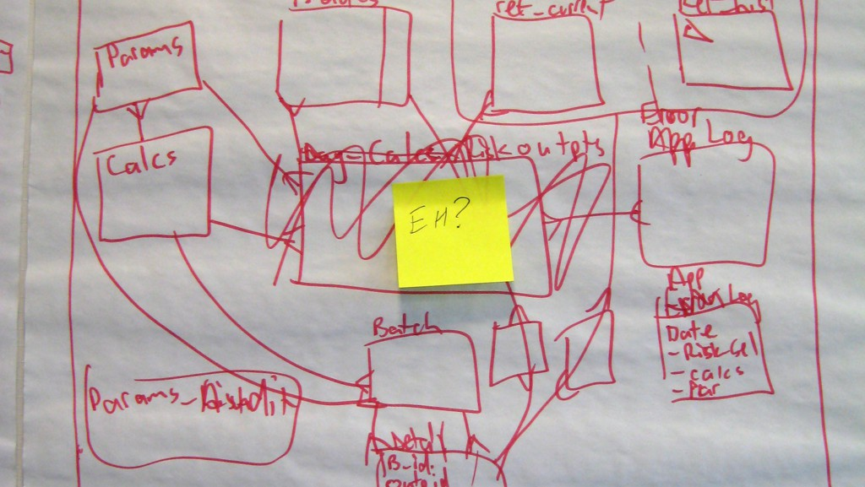

Slide 13
What about the quality?
Everyone was asked to grade the diagrams on a scale of 1-10.
Notes:
Regardless the experience of developers, they tend to grade every diagram as a 6/7. The main reason is that there is – most of the times – some value in every diagram but most of the times diagrams are missing a clear simple notation and contain elements on several levels for different stakeholders.

Slide 14
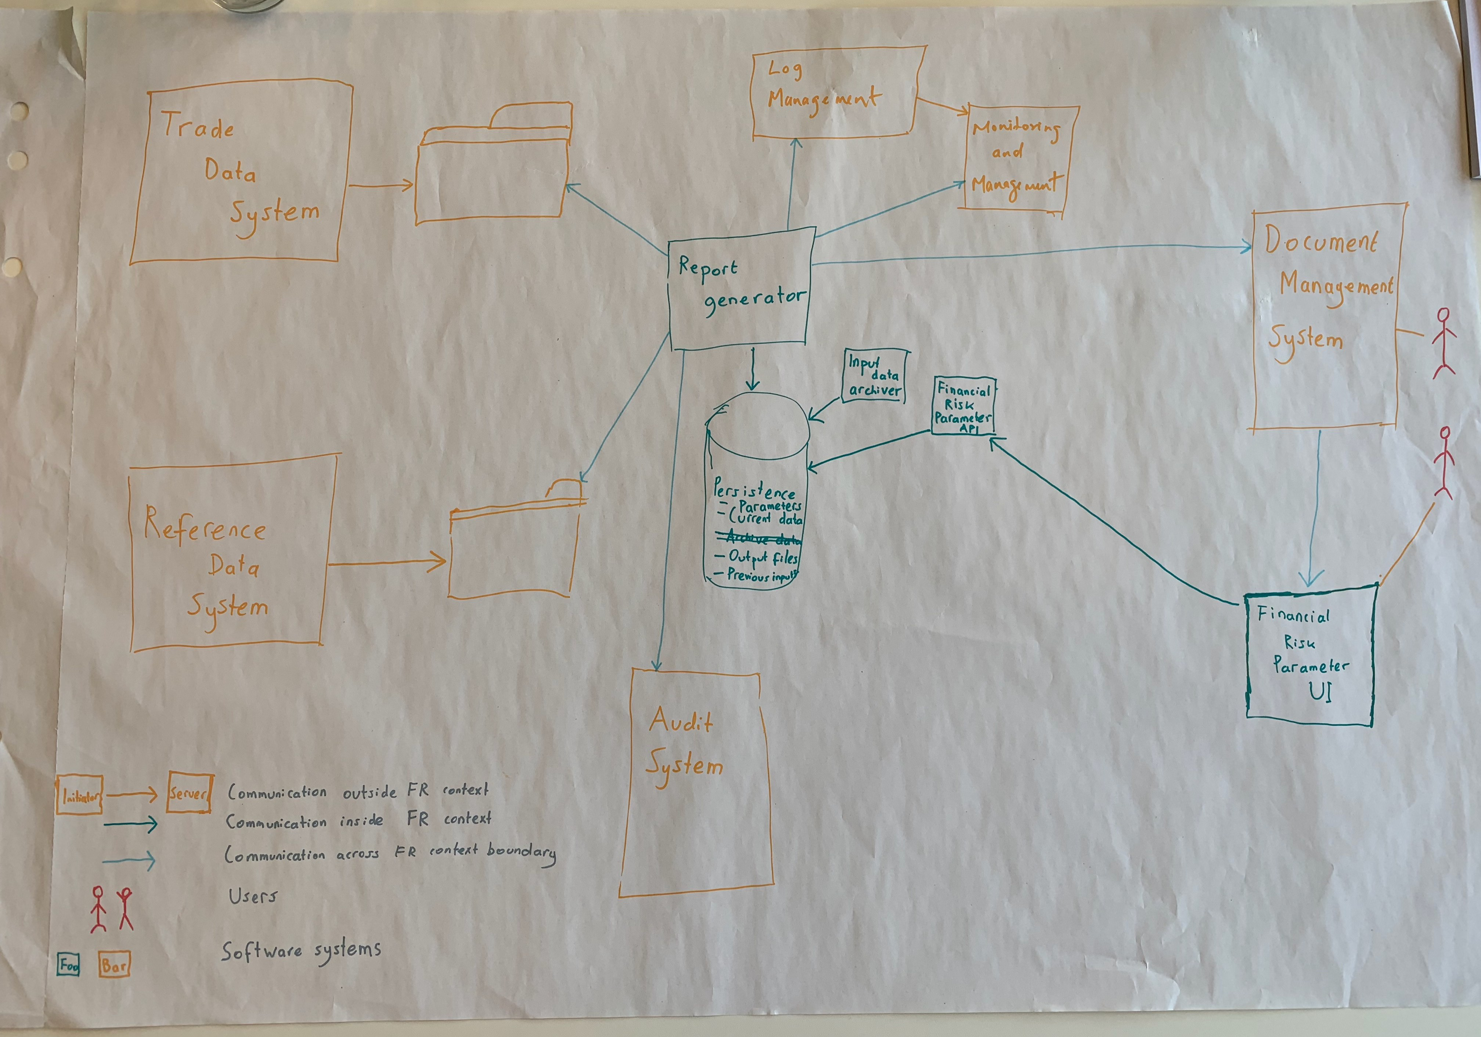

Slide 15
7

Slide 16
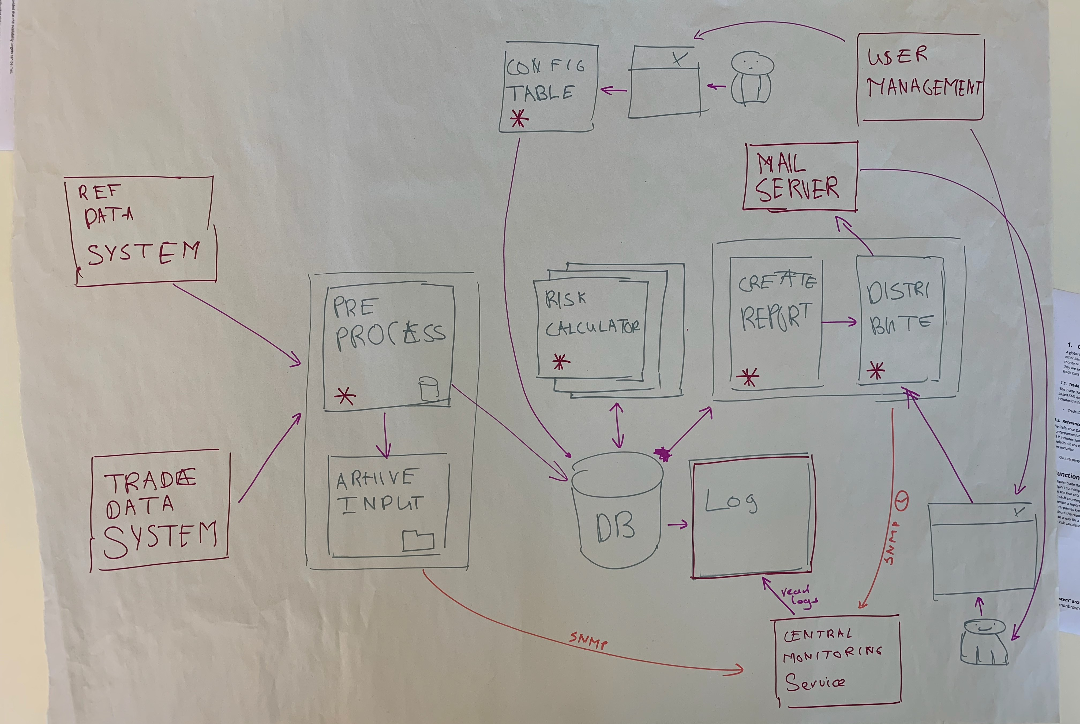

Slide 17
7

Slide 18
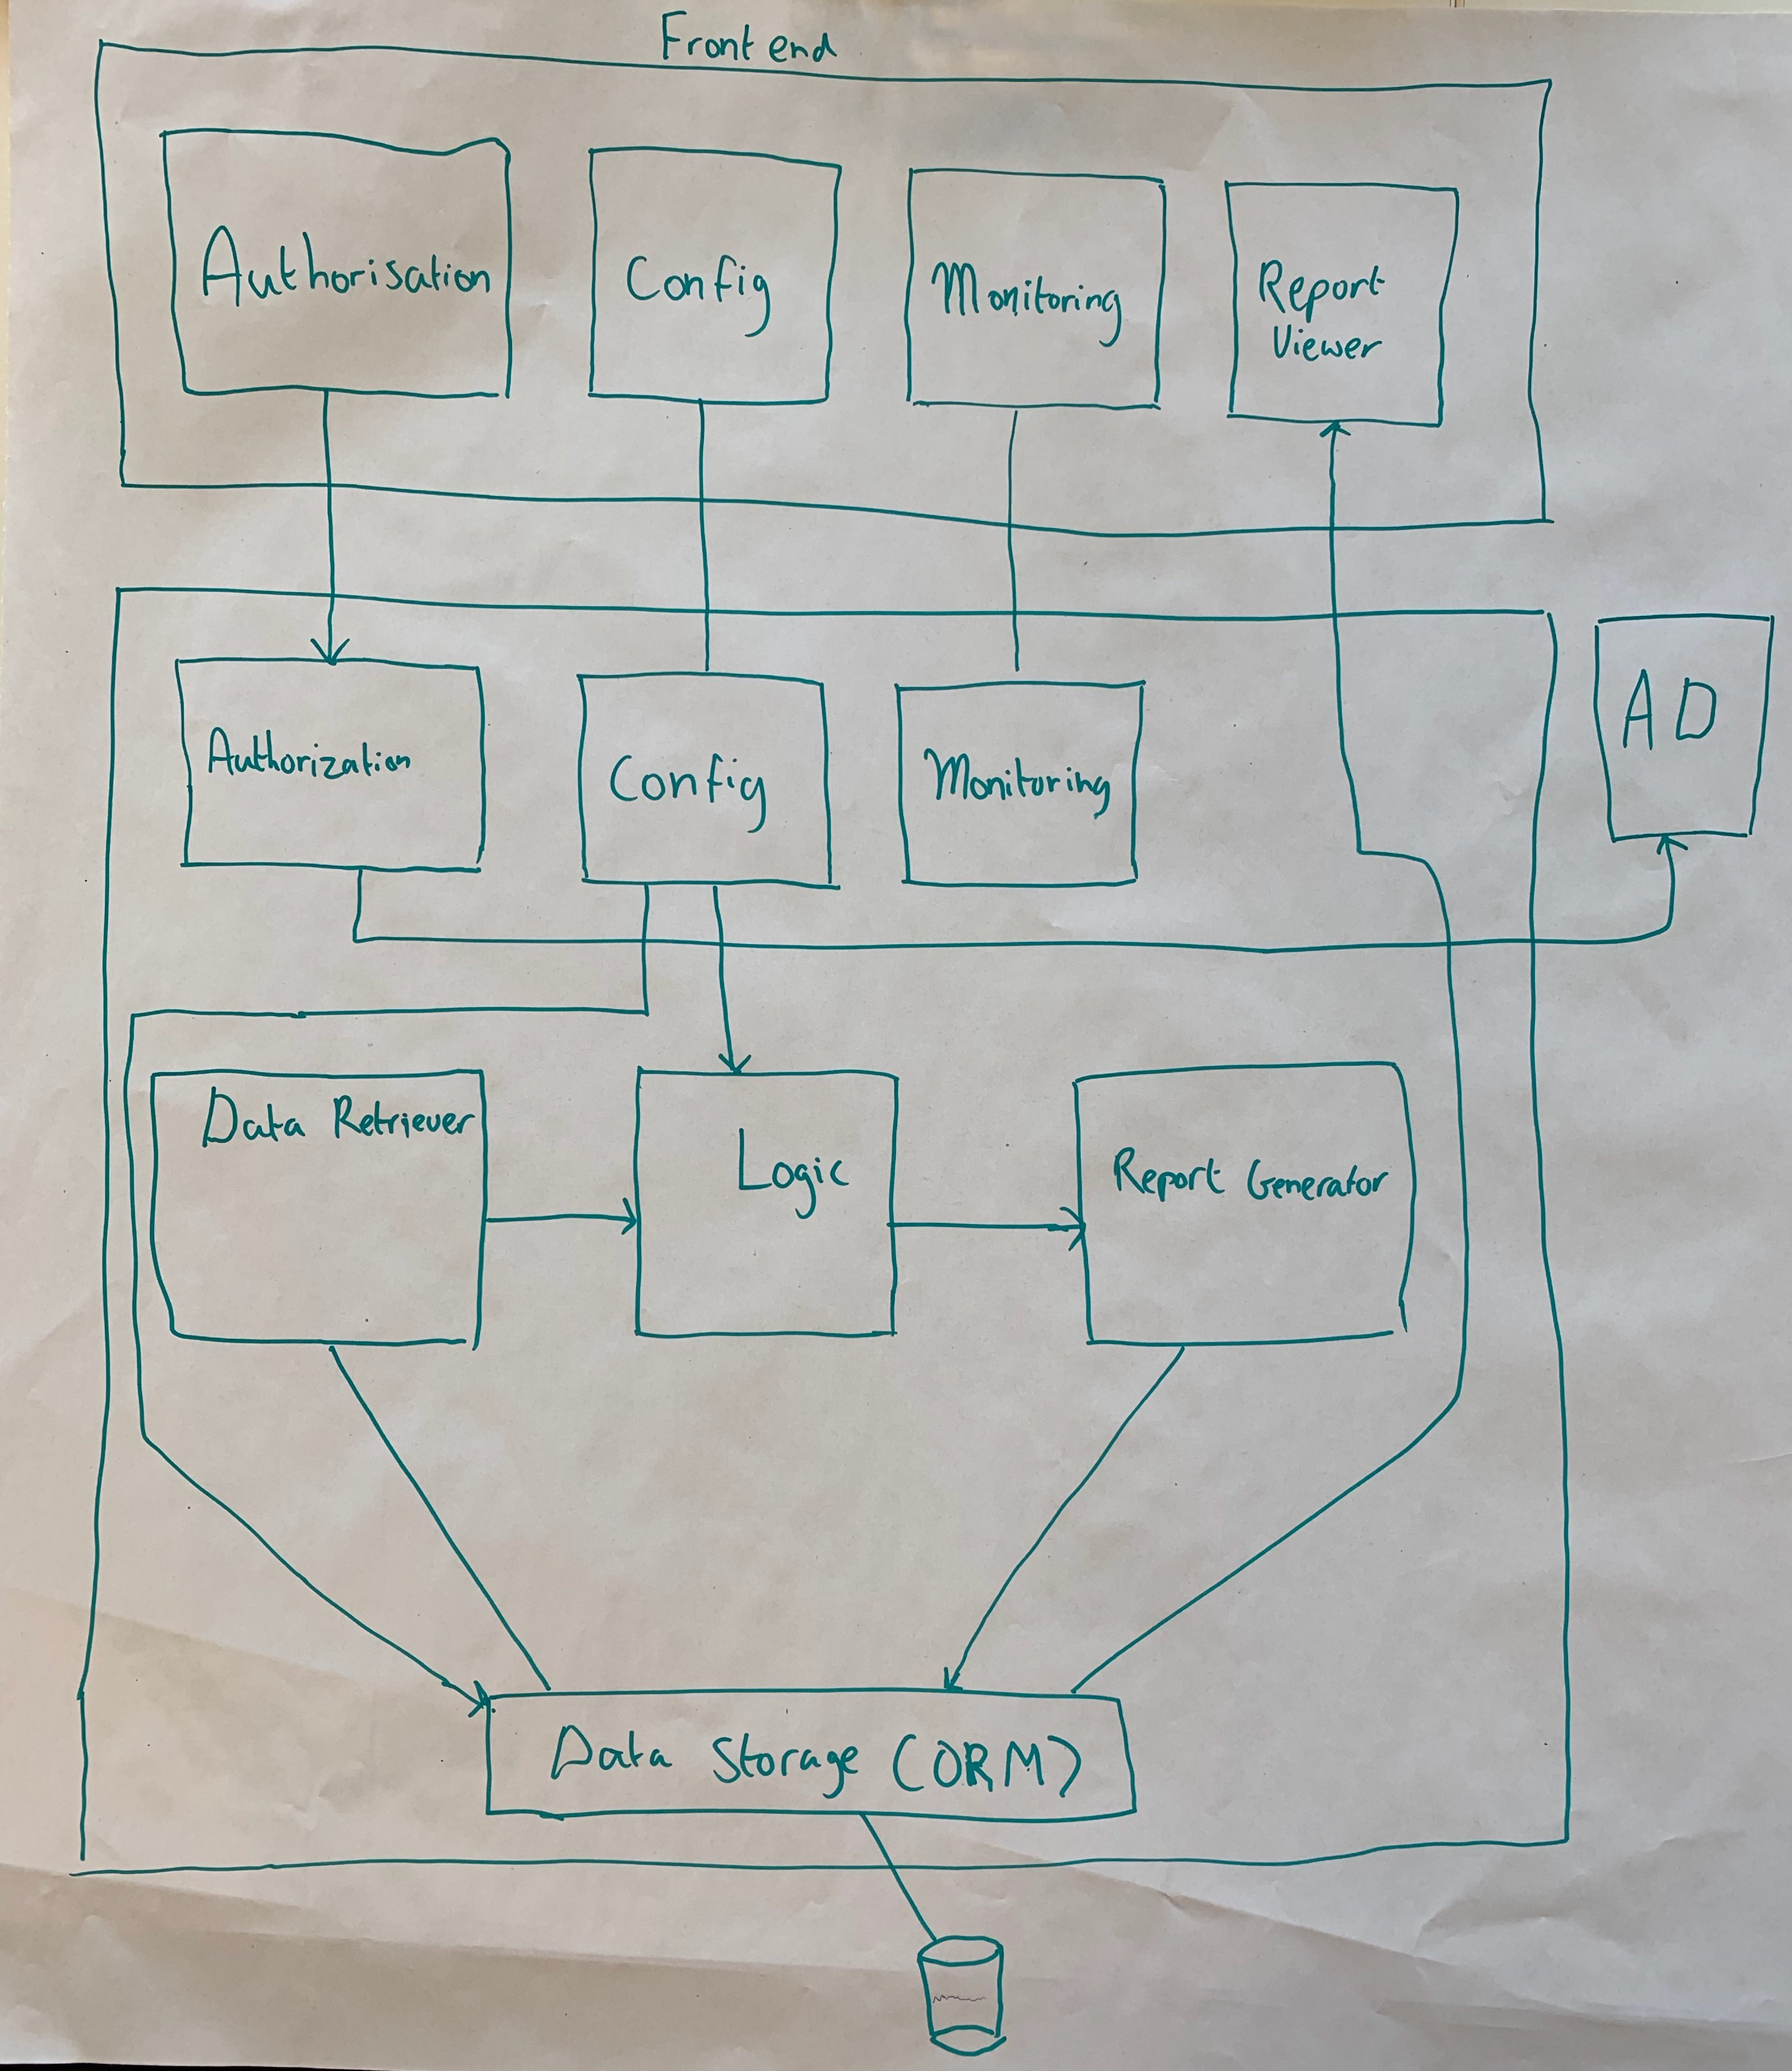
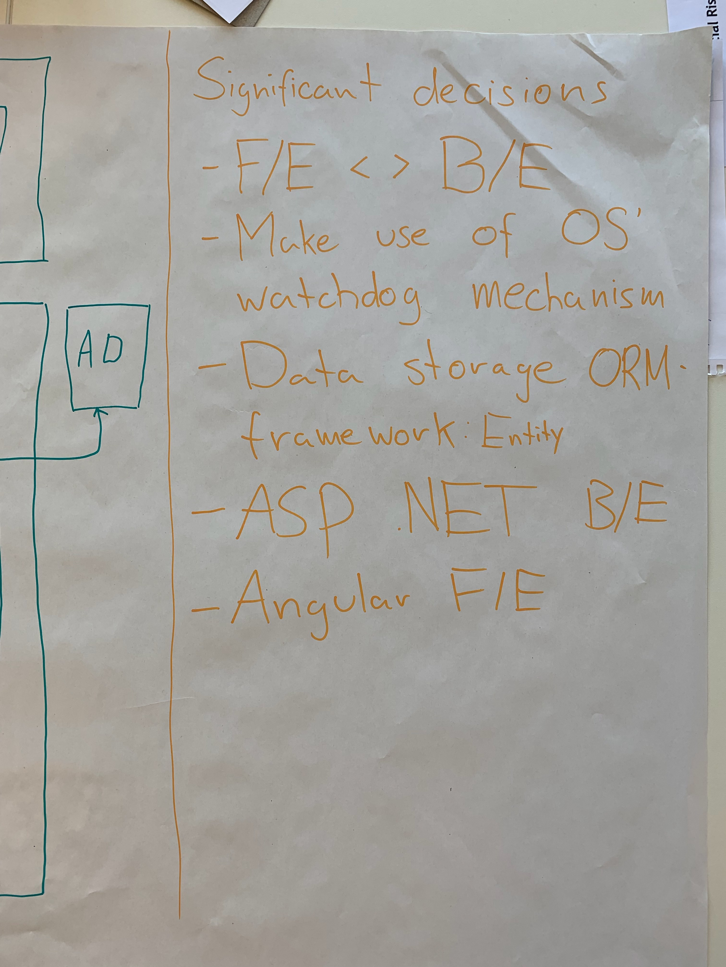

Slide 19
7

Slide 20
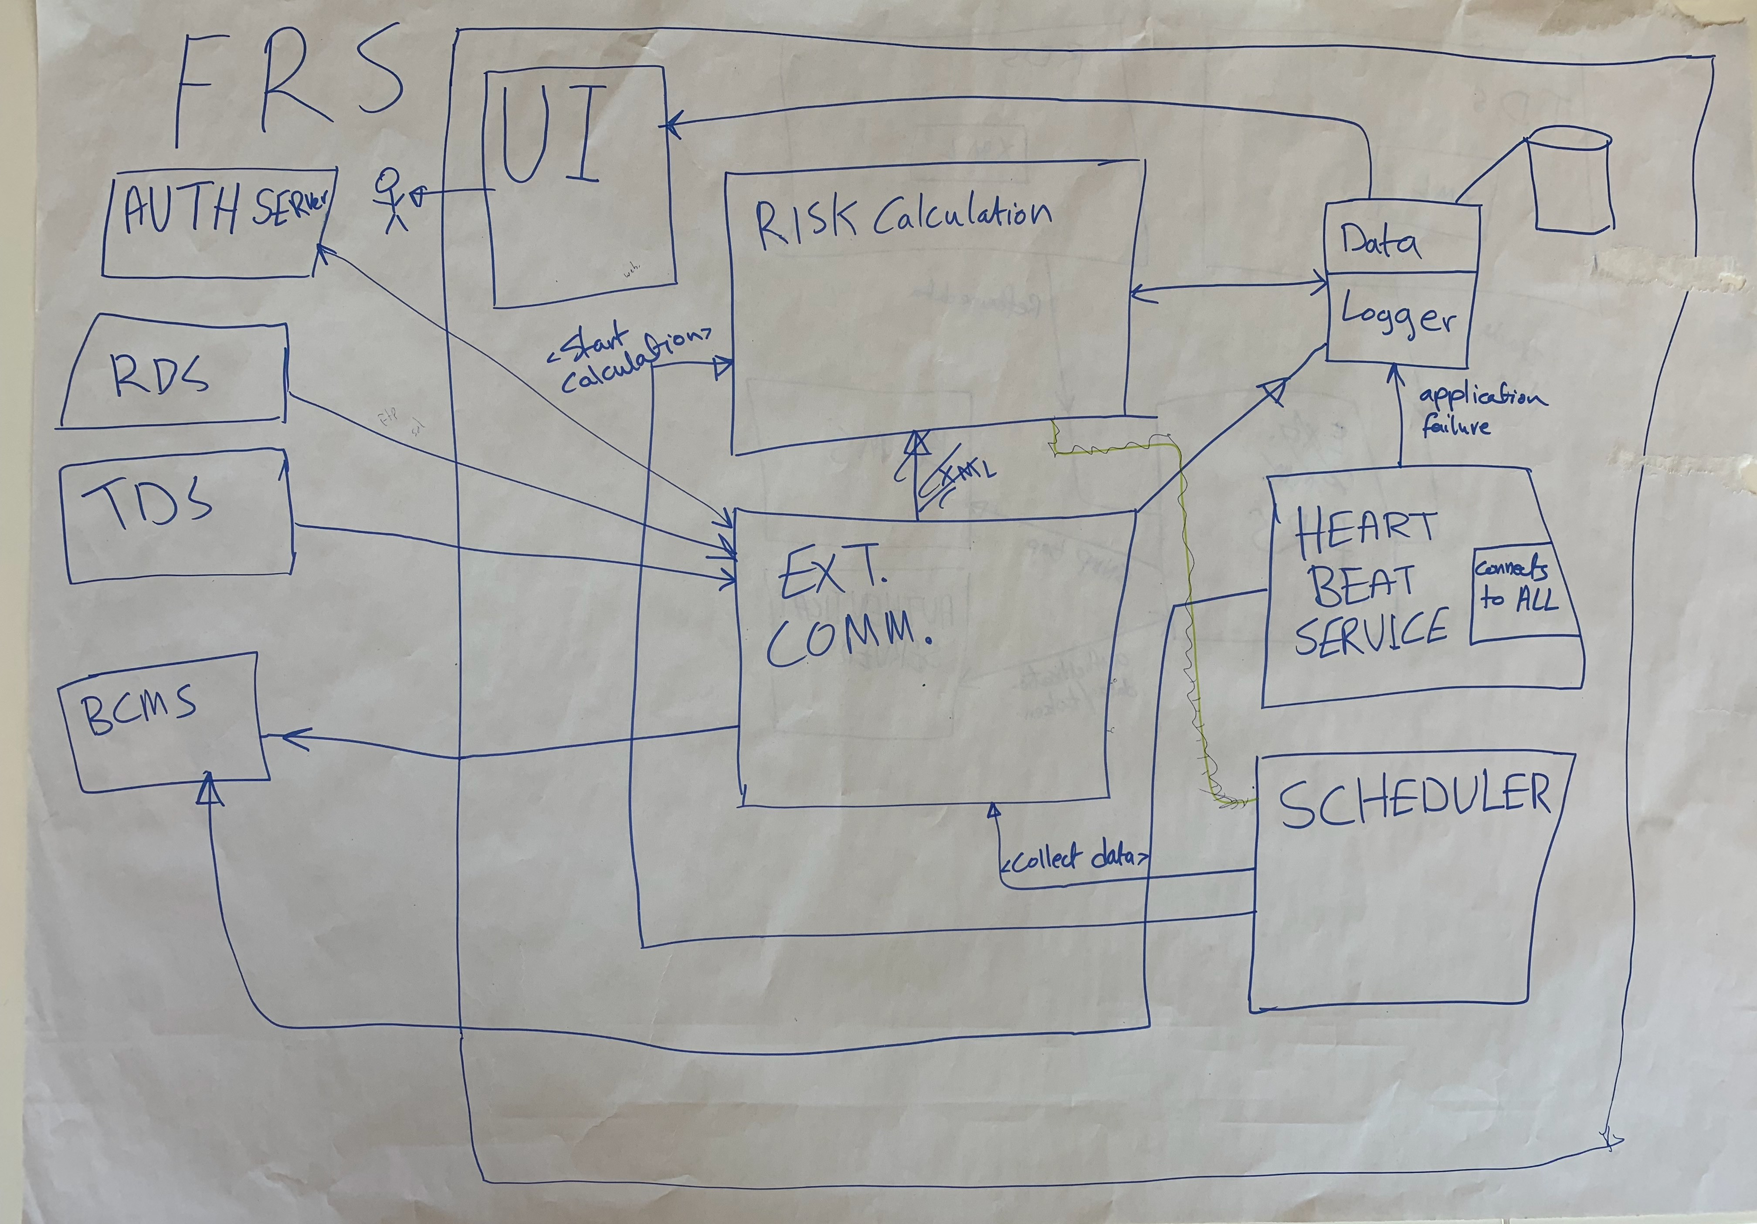

Slide 21
7

Slide 22
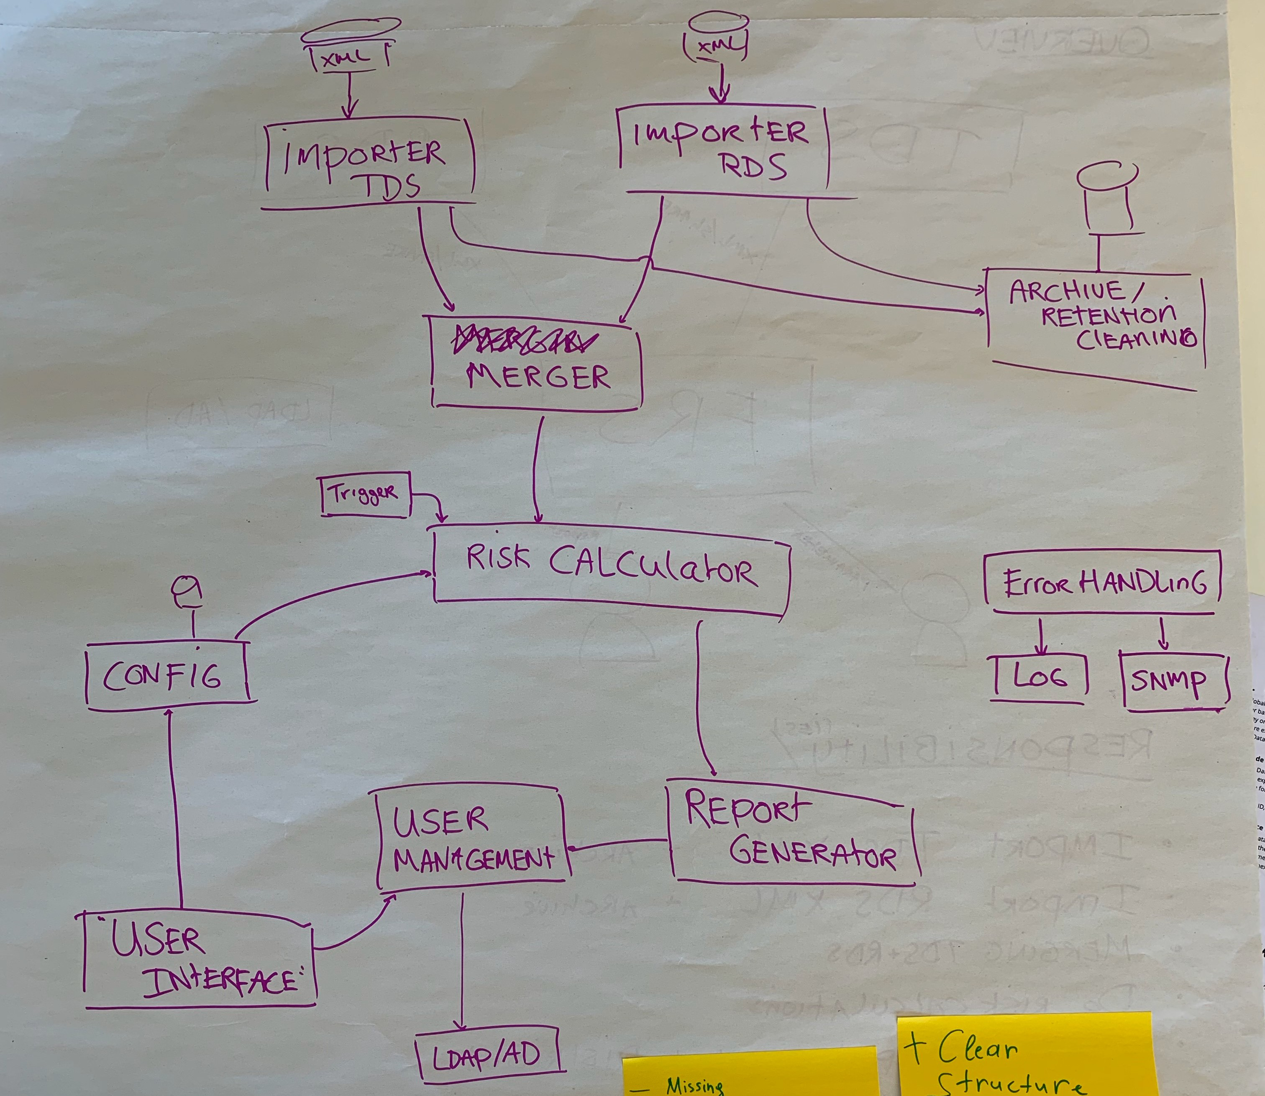

Slide 23
7

Slide 24
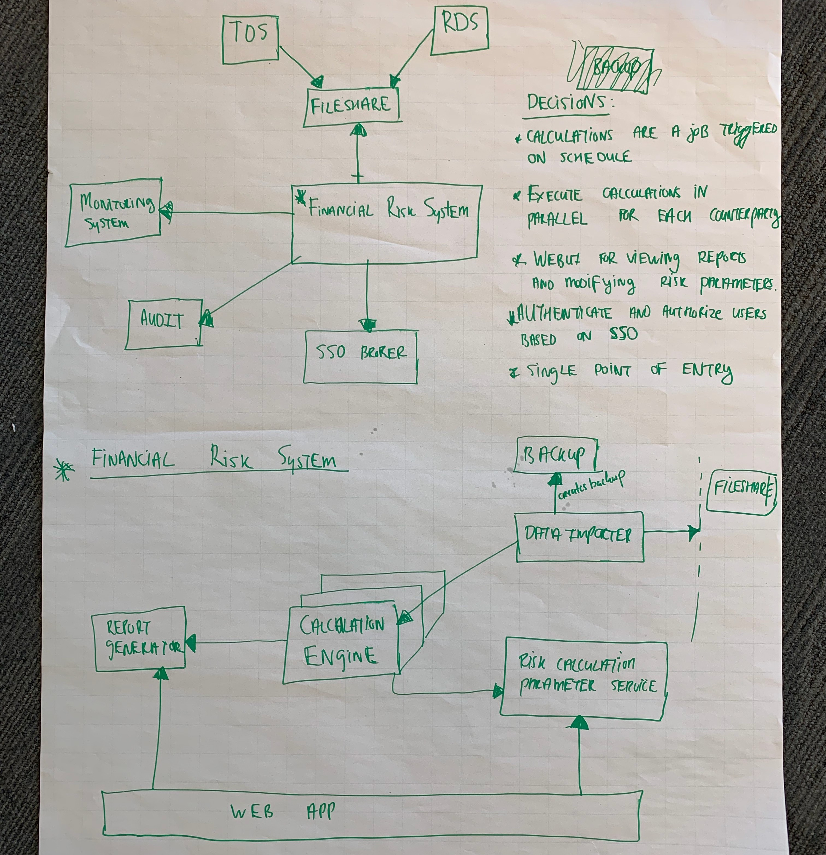

Slide 25
7

Slide 26
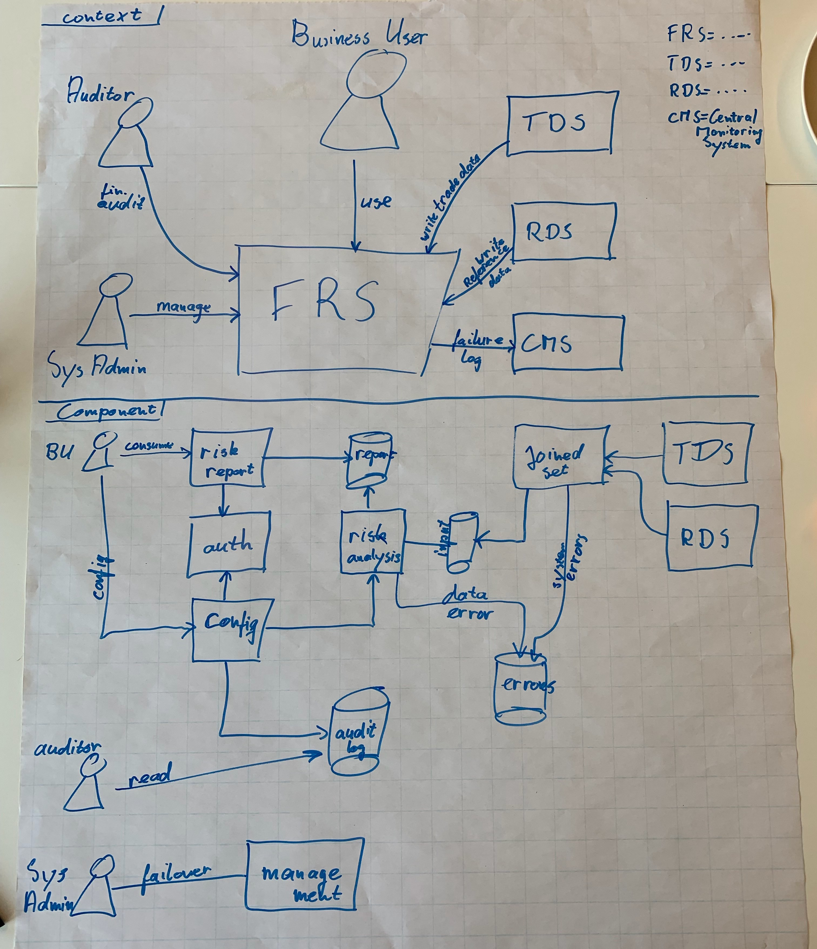

Slide 27
6

Slide 28
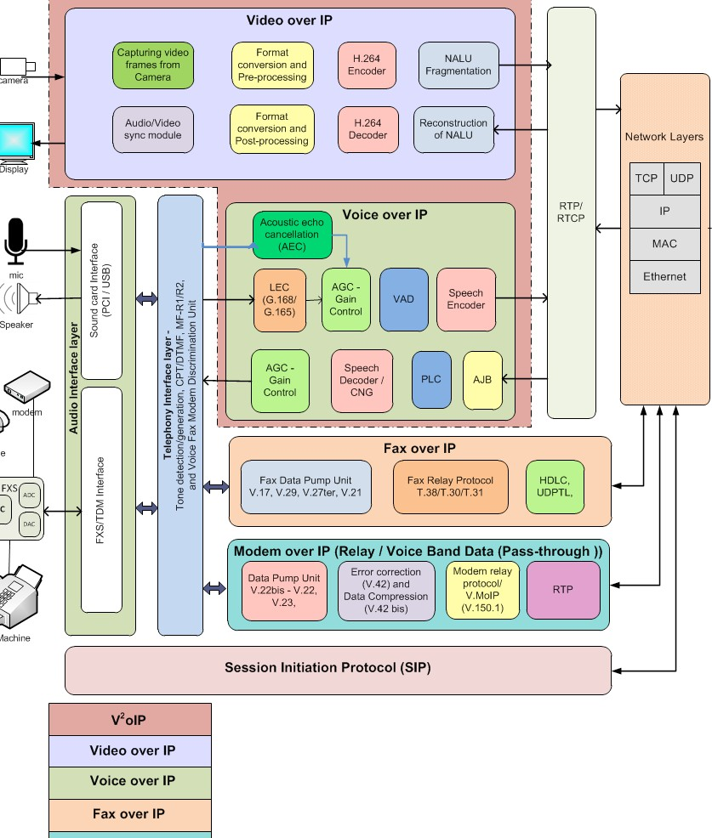
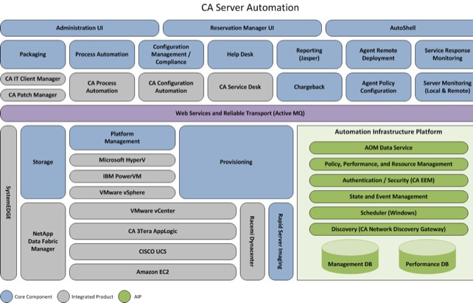
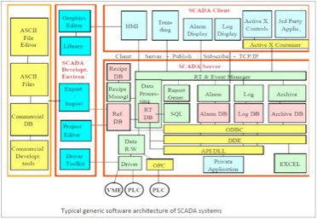
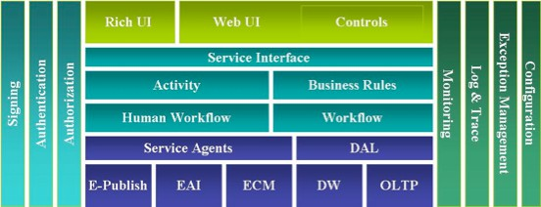
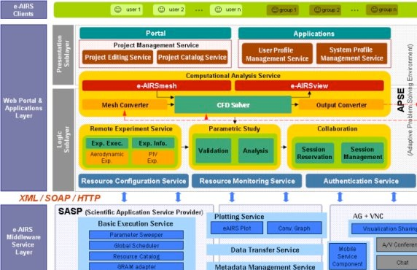
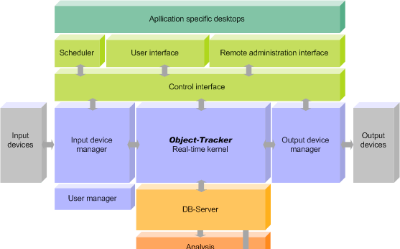

Slide 29
If you’re going to use “boxes & lines”, at least do so in a structured way, using a self-describing notation

Slide 30
Moving fast in the same direction as a team requires
good communication

Slide 31
The primary use for diagrams and documentation is
communication and learning

Slide 32
The C4 model is…
A set of hierarchical abstractions
(software systems, containers, components, and code)
A set of hierarchical diagrams
(system context, containers, components, and code)
Notation independent
Tooling independent
https://c4model.com/

Slide 33
The diagrams should spark
meaningful questions

Slide 34
No
“What does that arrow mean?” “Why are some boxes red?” “Is that a Java application?”
“Is that a monolithic application, or a collection of microservices?” “How do the users get their reports?”

Slide 35
Yes
“What protocol are your two Java applications using to communicate with each other?”
“Why do you have two separate C# applications instead of one?” “Why are you using MongoDB?”
“Why do you have both a RESTFul HTTP connection and a websocket connection between the React component and the Java back-end?”
“Why are you using MySQL when our standard is Oracle?”

Slide 36
Richer diagrams lead to richer design discussions

Slide 37
Richer diagrams lead to better communication, making it easier to scale teams

Slide 38
Similar levels of abstraction provide a way to easily compare solutions

Slide 39
To describe a software architecture,
“ ”
we use a model composed of
multiple views or perspectives.
Architectural Blueprints - The “4+1” View Model of Software Architecture
Philippe Kruchten

Slide 40
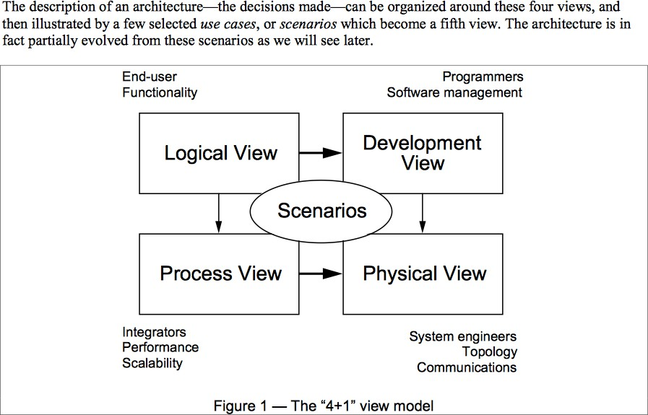
Notes:
Different stakeholders have different concerns that need a different/separate view on the situation. Instead of mixing up different levels of detail for several stakeholders, separate views for stakeholders with a clear set of models/diagrams.

Slide 41
Software System
Container
Container
Container
lient-side web app, server-side web app, console application,
(e.g. client-side web app, server-side web app, console application, mobile app, database schema, file system, object store, etc)
(e.g. client-side web app, server-side web app, console applic
obile app, database schema, file system, object store, etc)
mobile app, database schema, file system, object store, e
Component
Component
Component
Code
Code
Code
A software system is made up of one or more containers (applications and data stores), each of which contains one or more components, which in turn are implemented by one or more code elements (classes, interfaces, objects, functions, etc).

Slide 42
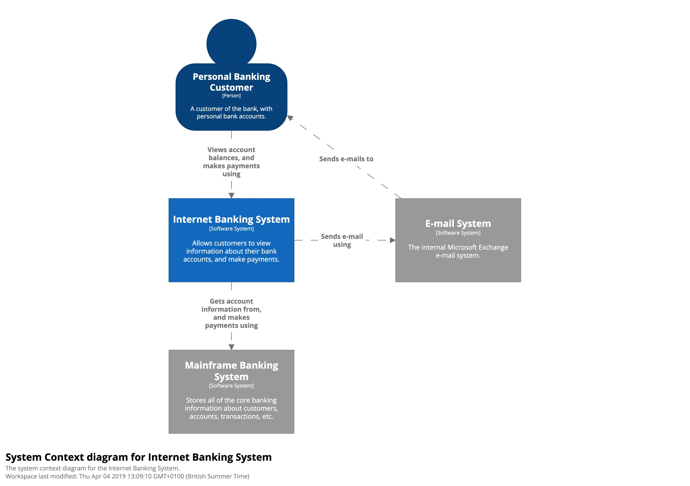

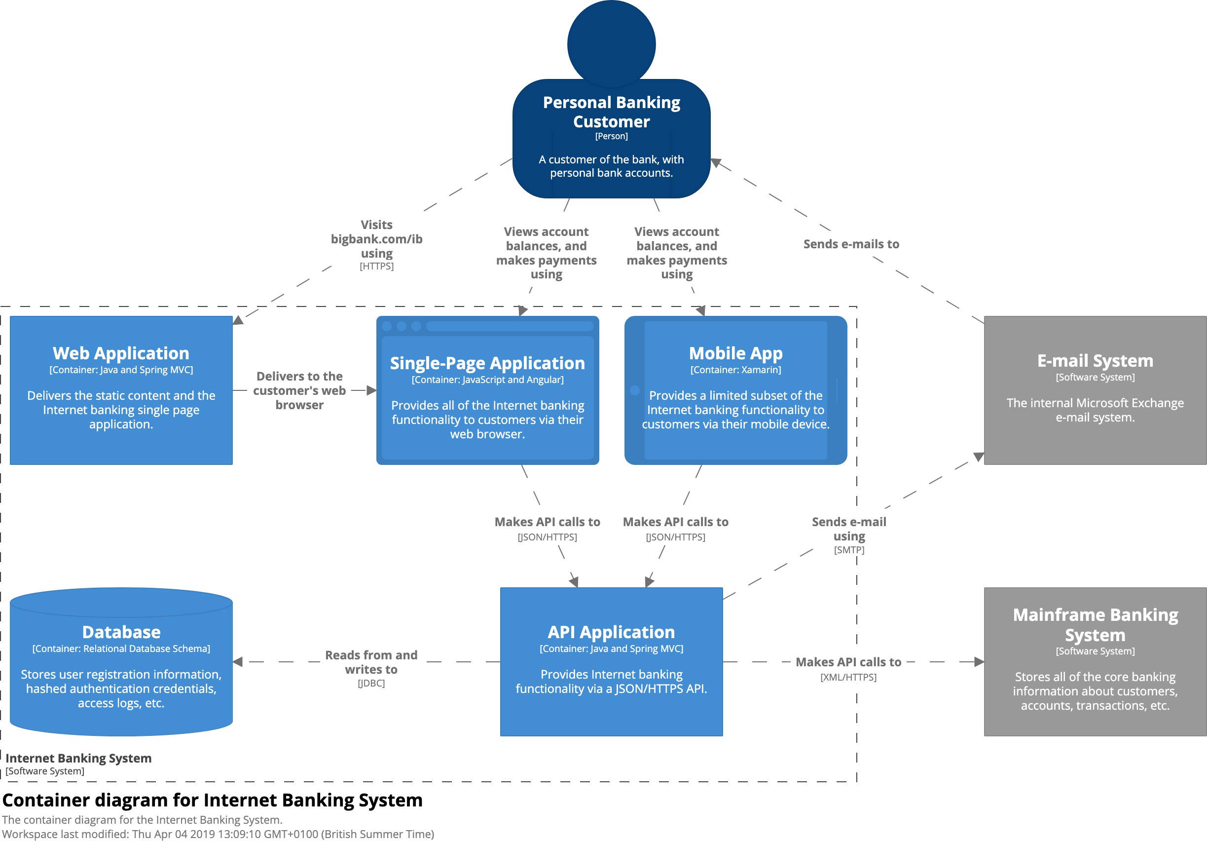

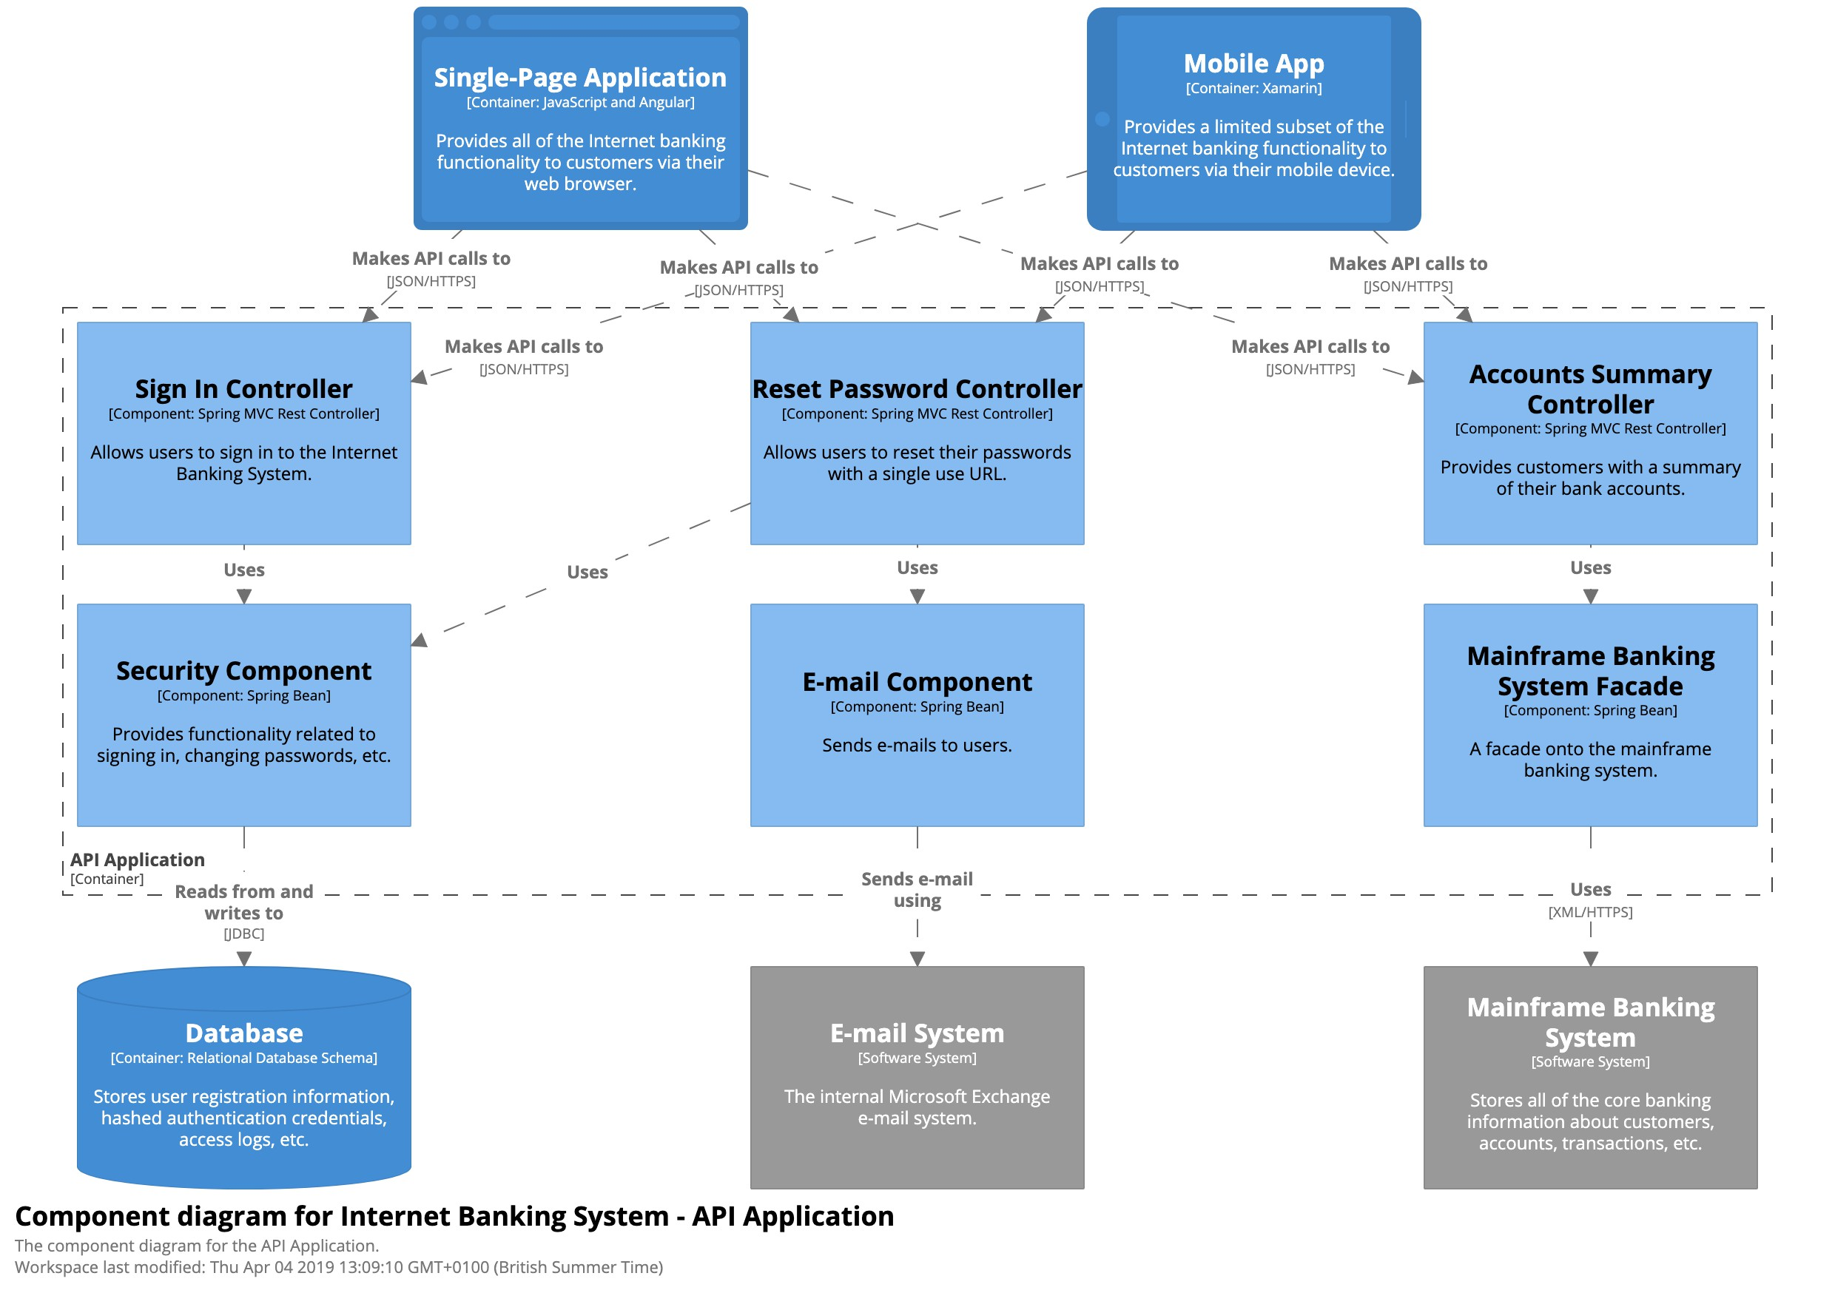

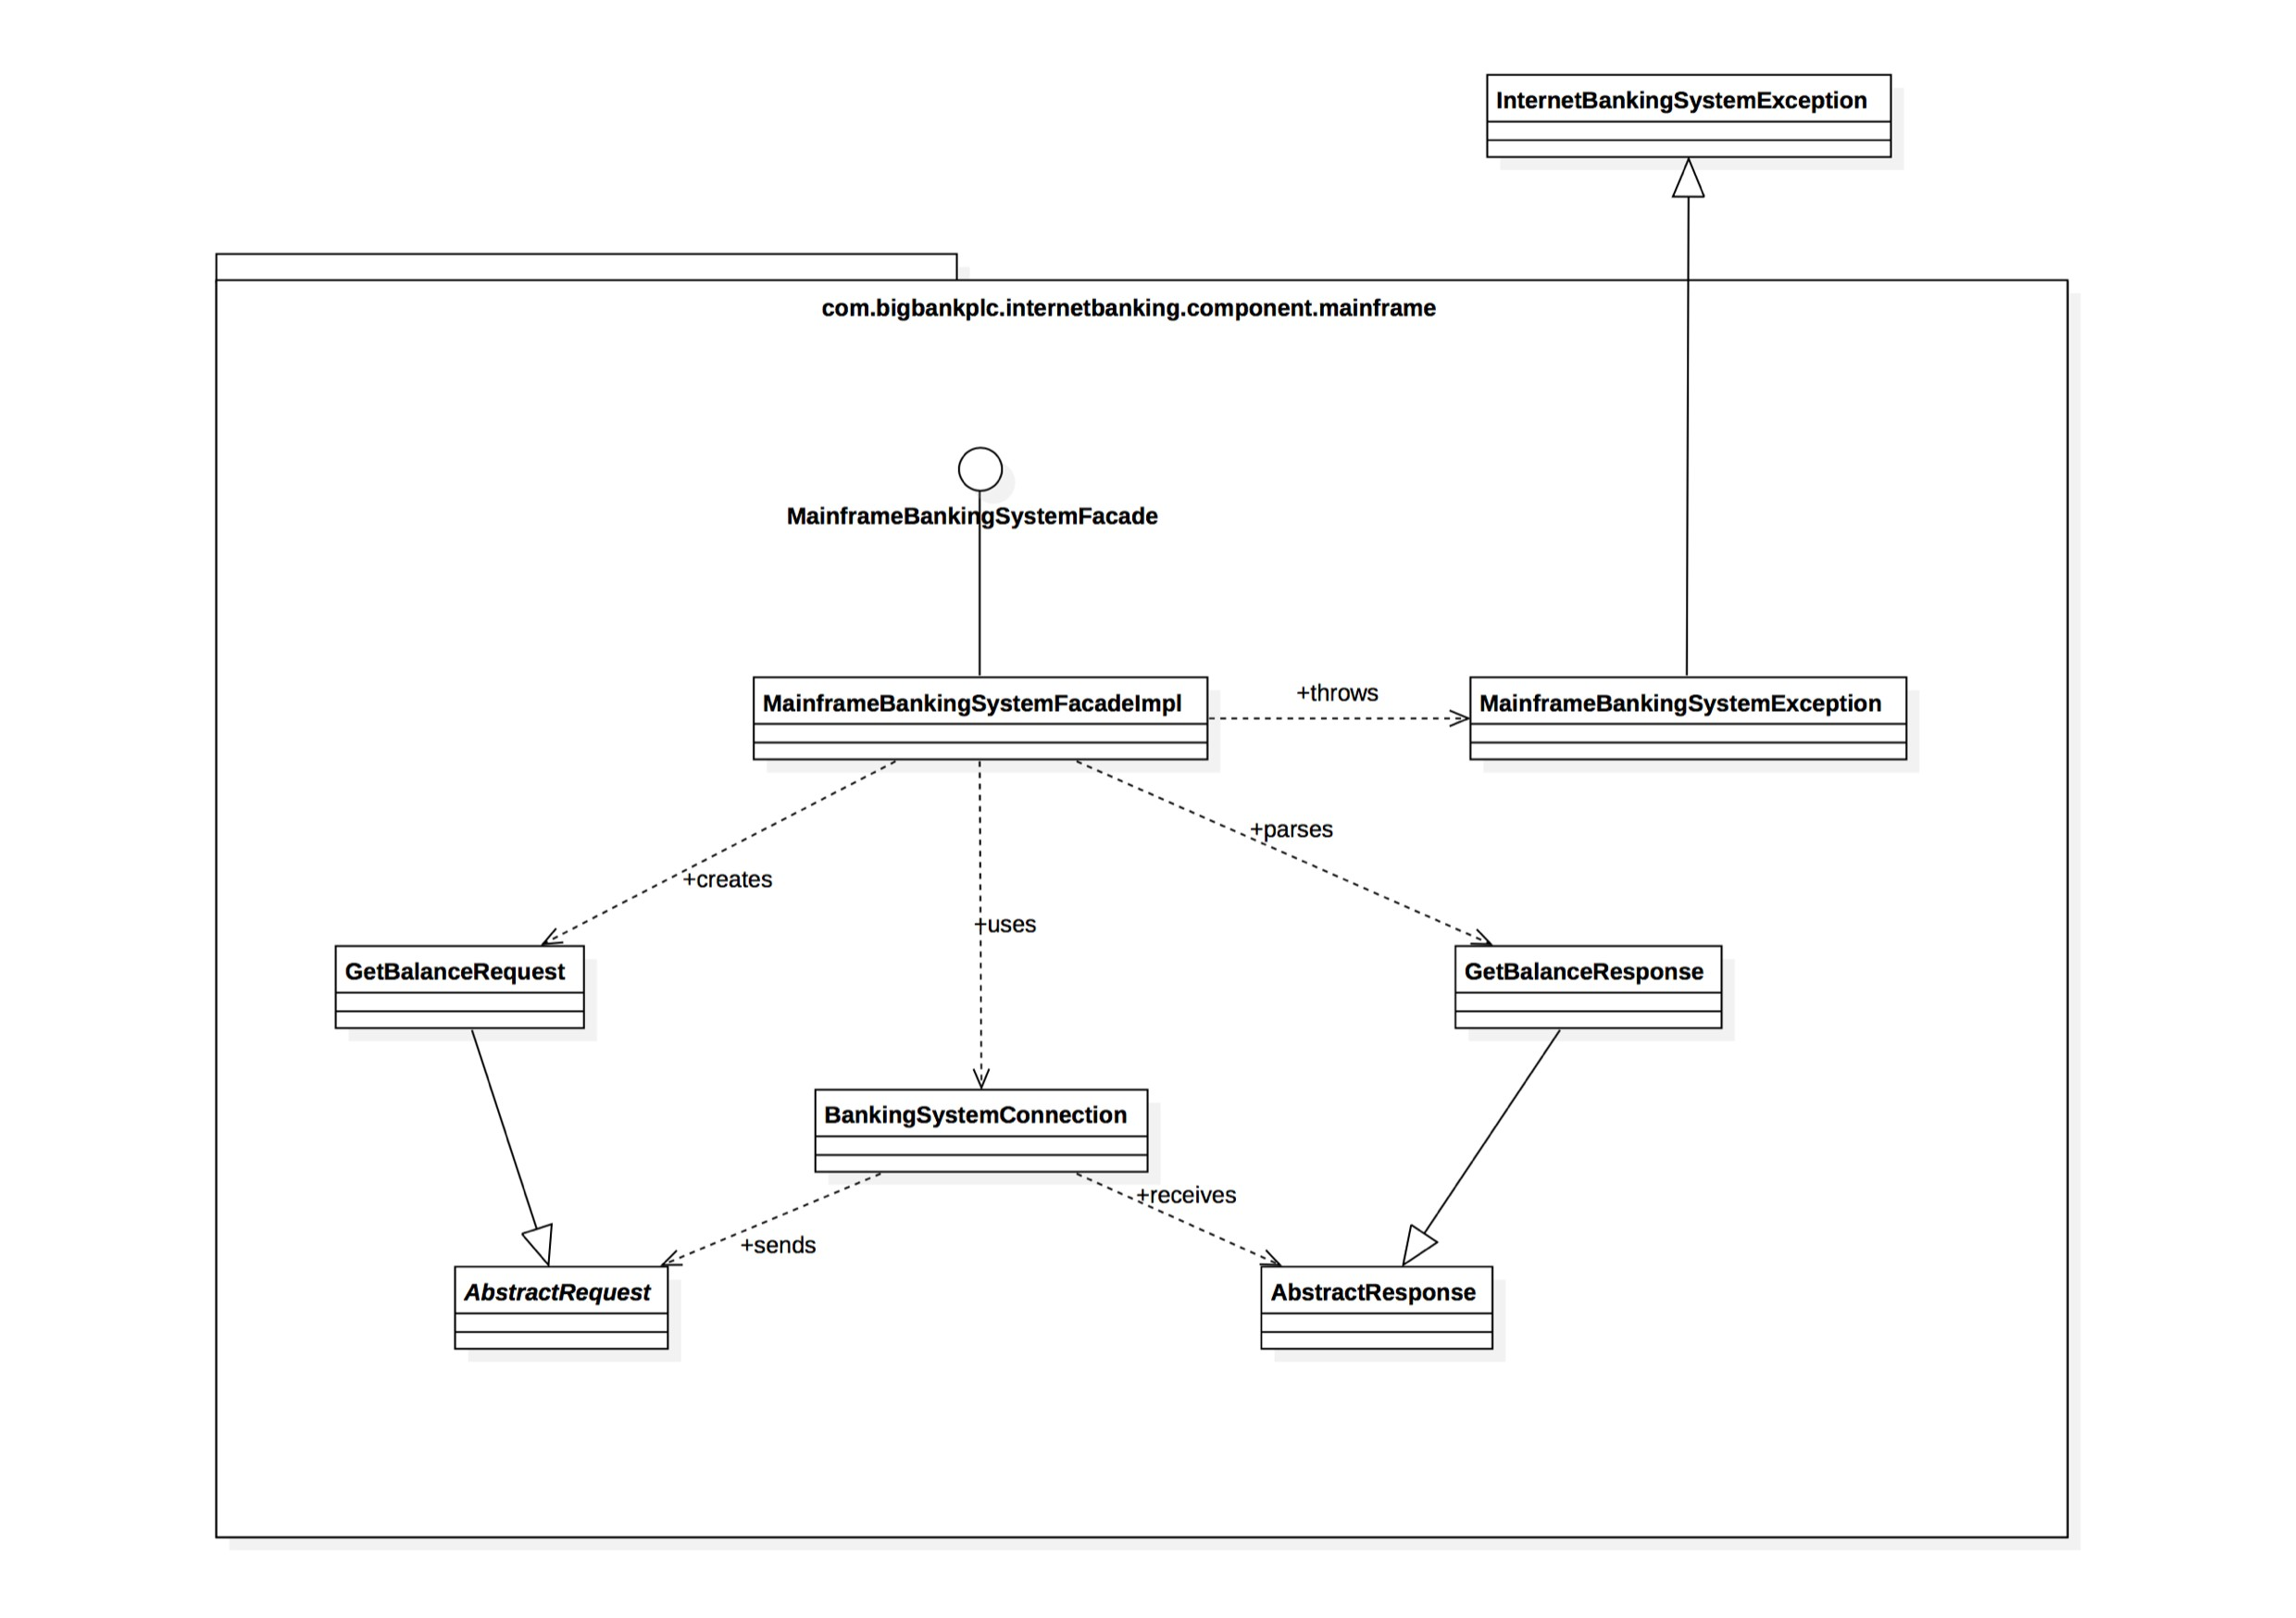
The C4 model for visualising software architecture
c4model.com
Zoom in
Zoom in
Zoom in
Level 1
Context
Level 2
Containers
Level 3
Components
Level 4
Code

Slide 43
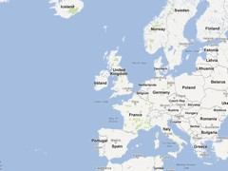


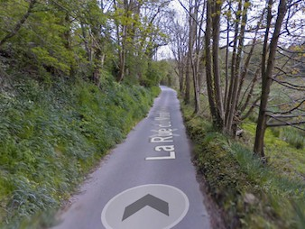
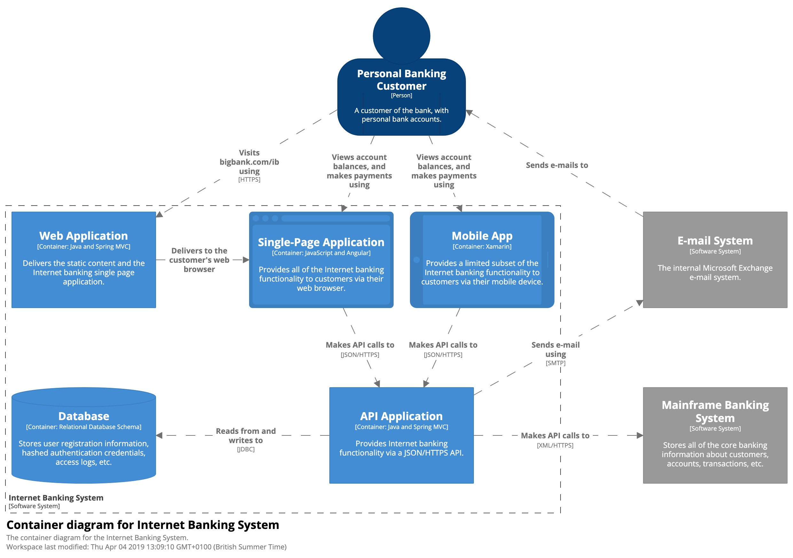
Diagrams are maps
that help software developers navigate a large and/or complex codebase

Slide 44
1. System Context
The system plus users and system dependencies.
Overview first
2. Containers
The overall shape of the architecture and technology choices.
3. Components
Logical components and their interactions within a container.
Zoom & filter
4. Code (e.g. classes)
Component implementation details.
Details on demand

Slide 45
Example
(Internet Banking System)

Slide 46
Static diagrams

Slide 47
Level 1
System Context diagram

Slide 48
System Context diagram
A context diagram helps you to answer the following questions.
1. What is the software system that we are building (or have built)?
2. Who is using it?
3. How does it fit in with the existing environment?

Slide 49
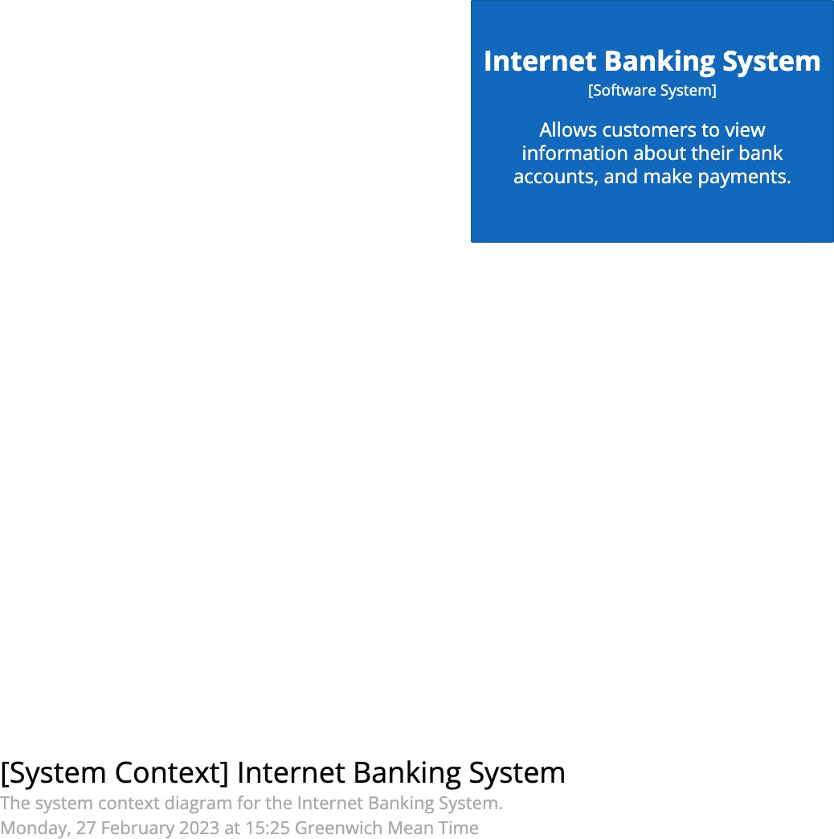
• Name: The name of the software system.
• Description: A short description of the software system, its responsibilities, etc.
https://c4model.com/diagrams/system-context

Slide 50
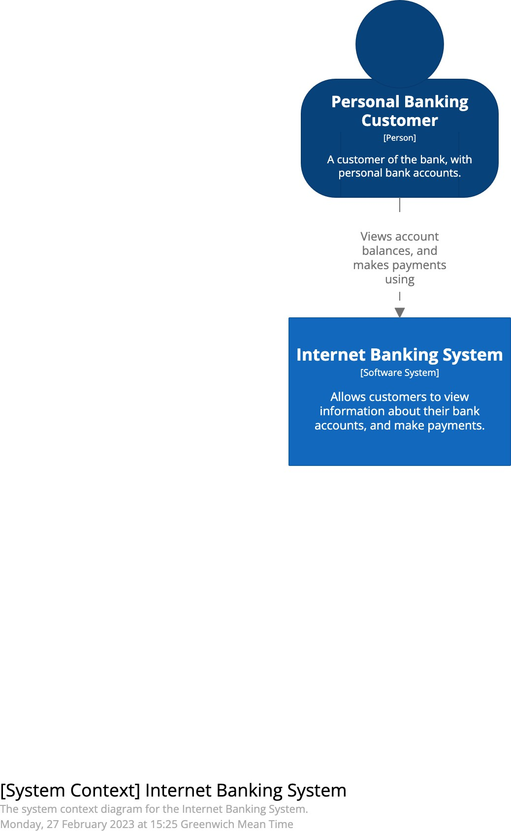
These are the people who use your software system. Whether you model them as individual people, users, roles, actors or personas is your choice.
Typically capture the following information about people:
• Name: The name of the person, user, role, actor or persona.
• Description: A short description of the person, their role, responsibilities, etc.

Slide 51
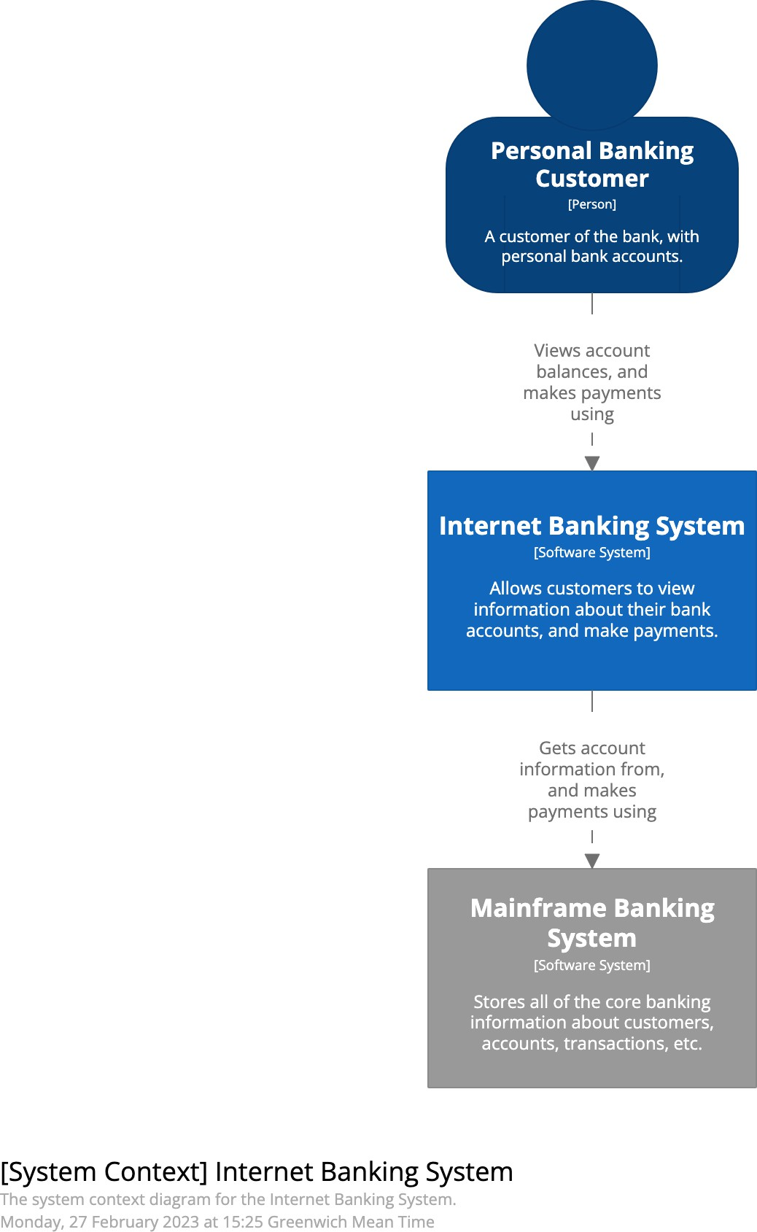
• Name: The name of the external software system.
• Description: A short description of the software system, its responsibilities, etc.

Slide 52
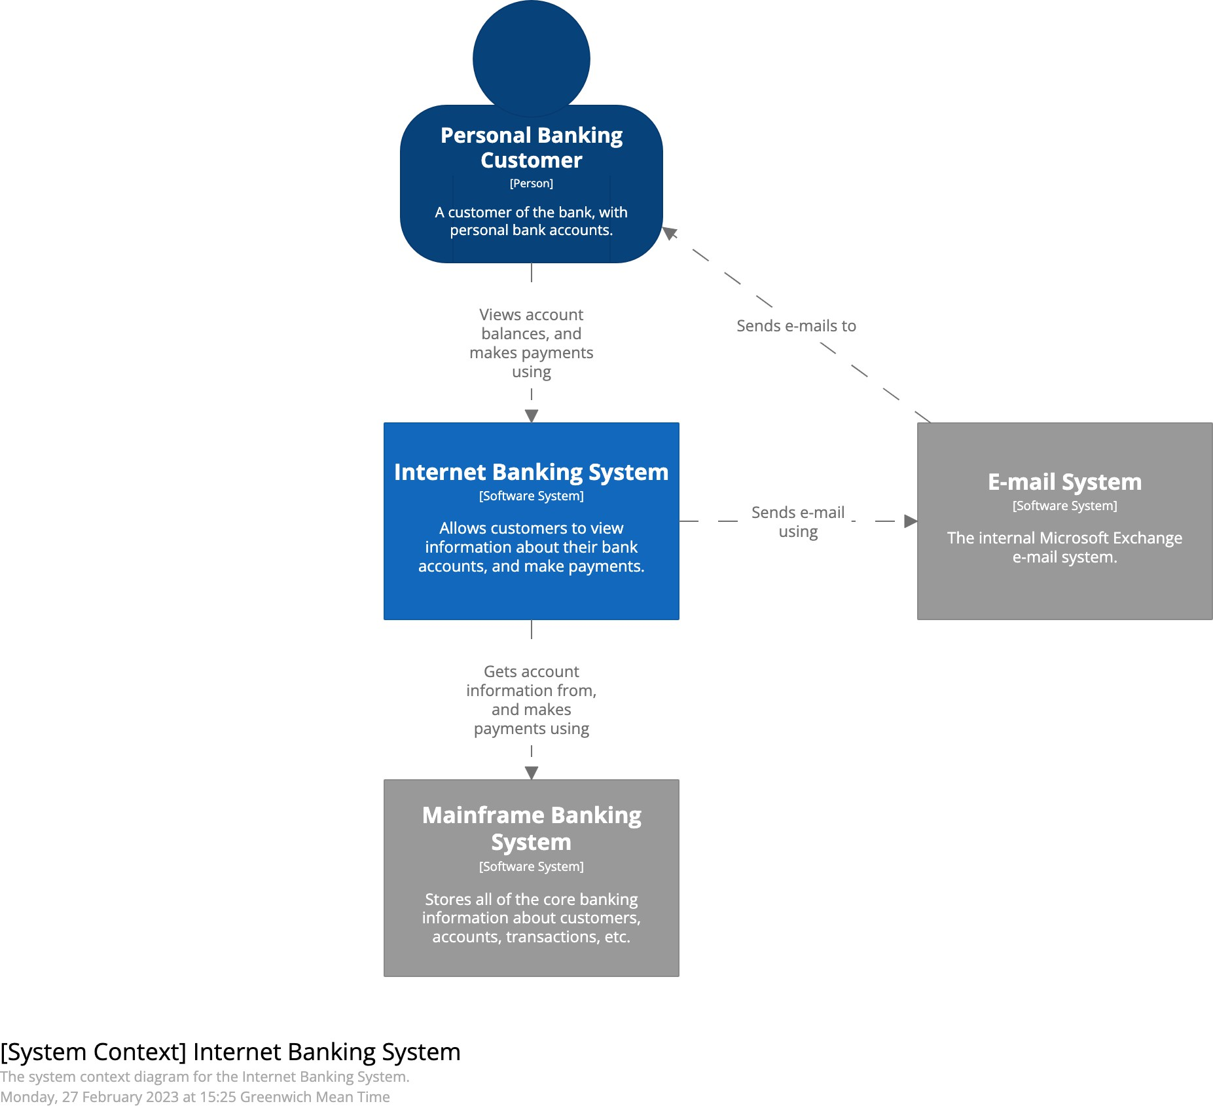
Try to annotate every interaction between people and software systems on the diagram with some information about the purpose of that interaction. This avoids creating a diagram where a collection of boxes are somehow connected via a set of ambiguous lines.

Slide 53
Level 2
Container diagram

Slide 54
Container diagram
The container diagram shows the high-level shape of the software architecture and how responsibilities are distributed across it. It also shows the major technology choices, how they are used and how containers communicate with each other. It’s a simple, high-level technology focussed diagram that is useful for software developers and support/operations staff alike. A container diagram helps you answer the following questions:
1. What is the overall shape of the software system?
2. What are the high-level technology decisions?
3. How are responsibilities distributed across the system?
4. How do containers communicate with one another?
5. As a developer, where do I need to write code in order to implement features?

Slide 55

The container diagram shows the containers that reside inside the software system boundary

Slide 56
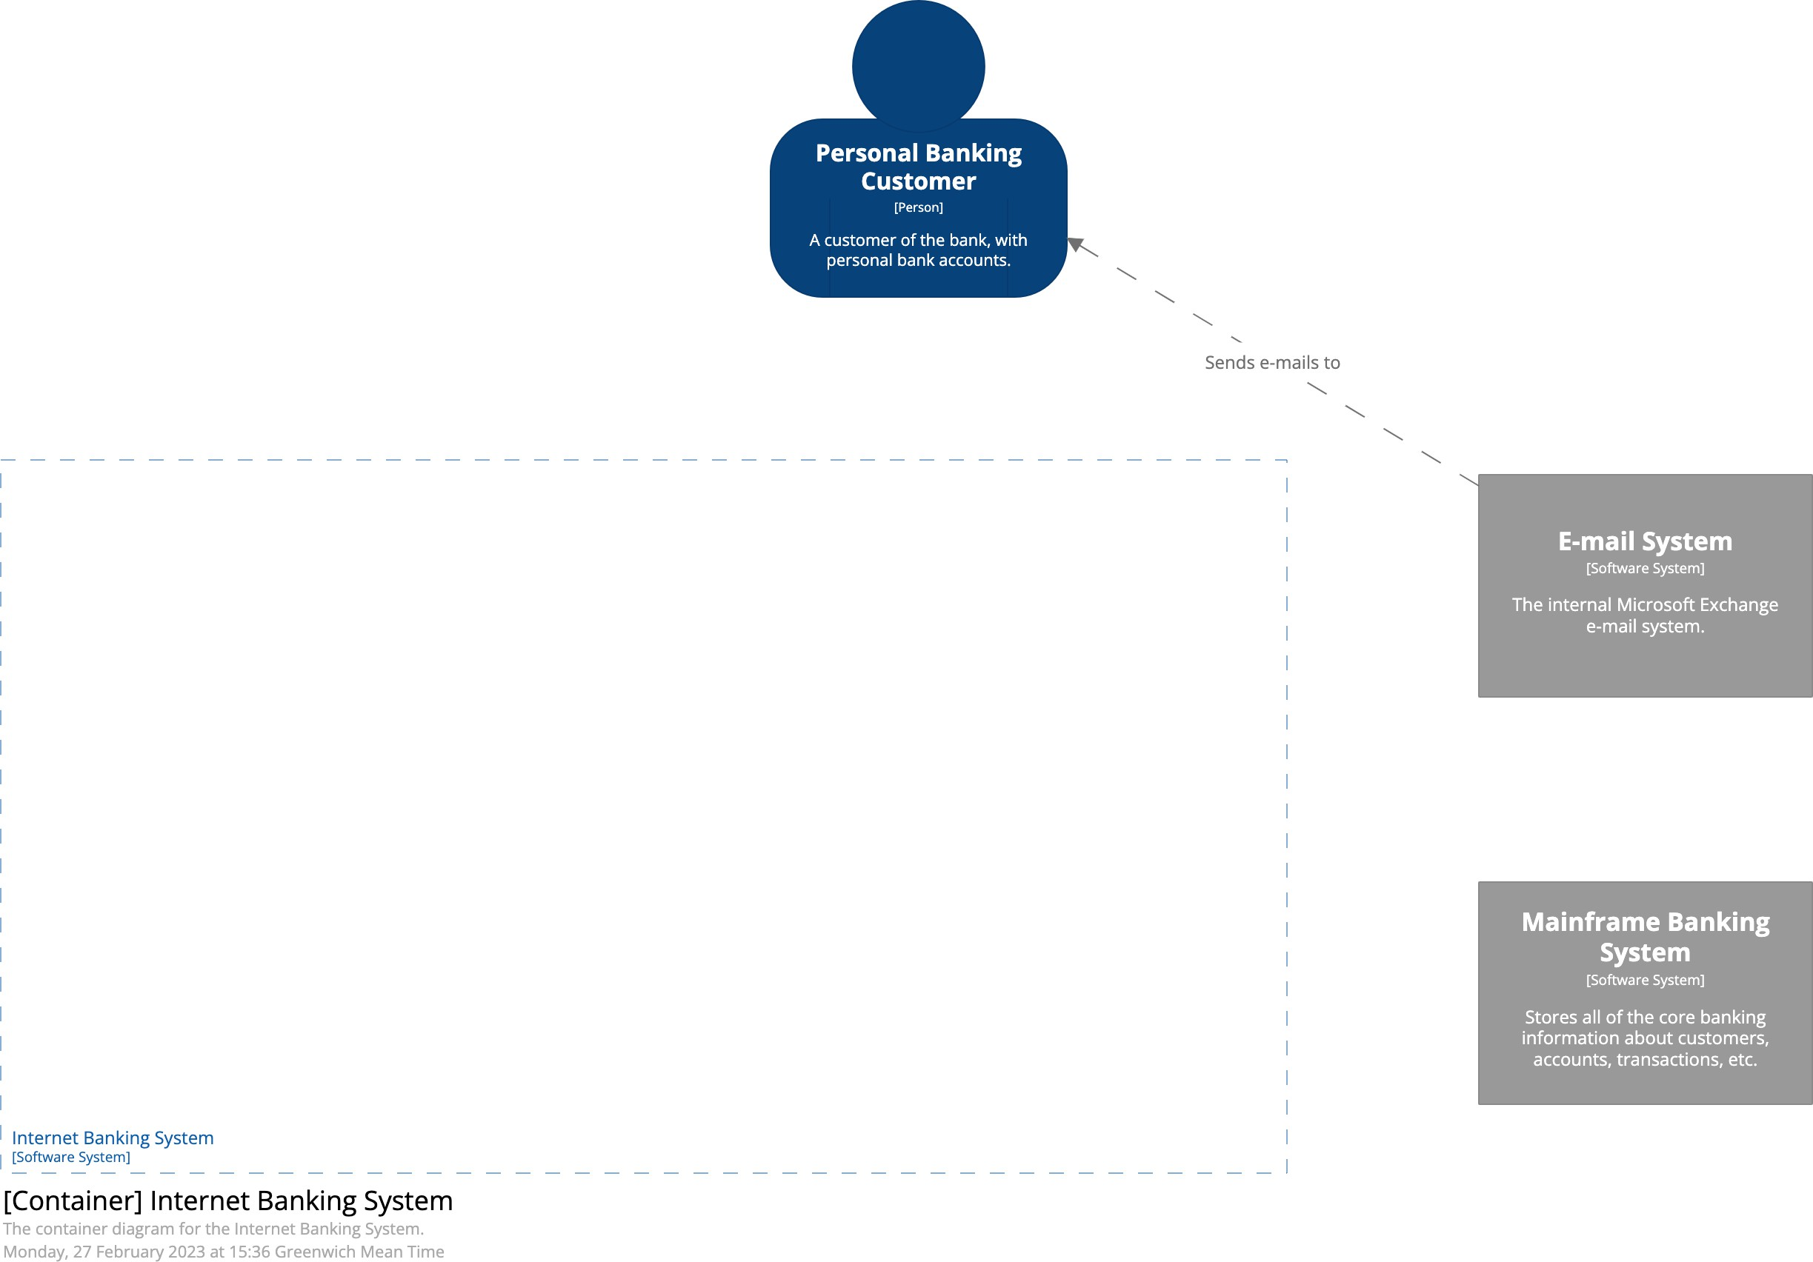
https://c4model.com/diagrams/container

Slide 57

A container represents an execution/runtime environment or data storage. Capture the following information about each container:
• Name: The name of the container (e.g. “Internet-facing web server”, “Database”, etc).
• Technology: The implementation technology (e.g. Spring MVC application on Apache Tomcat 8, ASP.NET web application on Microsoft IIS 8.5, etc).
• Description: A short descriptive statement. In the case of execution environments, this is a list of the container’s key responsibilities. In the case of a data store, I’ll list the major entities, tables, files, etc that are being stored.

Slide 58

Typically, communication between containers is out-of-process (or inter-process). It’s very useful to explicitly identify this and summarise how these interfaces will work. As with any diagram, we recommend annotating all interactions rather than simply having a diagram with a collection of boxes and ambiguous unlabelled lines connecting everything together. Useful information to annotate the interactions with includes:
• The purpose of the interaction (e.g. “reads/writes data from”, “sends reports to”, etc).
• The communication mechanism (e.g. Web Services, REST, Web API, Java Remote
Method Invocation, Windows Communication Foundation, Java Message Service).
• The communication style (e.g. synchronous, asynchronous, batched, two-phase commit, etc).
• Protocols and port numbers (e.g. HTTP, HTTPS, SOAP/HTTP, SMTP, FTP, RMI/IIOP,
etc).

Slide 59


Slide 60


Slide 61


Slide 62
Runtime/behavioural diagrams part I

Slide 63
Static structure diagrams are very useful, but they don’t tell the whole story

Slide 64
This is still a container diagram but now you see the order in which the containers operate to fulfill a certain feature. It’s like a sequence diagram.

Slide 65
Level 3
Component diagram

Slide 66
Component diagram
A component diagram helps you answer the following questions.
1. What components is each container made up of?
2. Do all components have a home (i.e. reside in a container)?
3. It is clear how the software works at a high-level?

Slide 67

The component diagram shows the components that reside inside an individual container

Slide 68

https://c4model.com/diagrams/component

Slide 69

Components are the coarse-grained building blocks of your software system that live inside of a container. I’ll capture the following information for each component:
• Name: The name of the component.
• Technology: The implementation technology for the component (e.g. Plain Old [Java|C#|Ruby|etc] Object, Azure Function, Spring Controller, React Component, etc).
• Description: A short description of the component, usually a brief sentence describing the component’s responsibilities.

Slide 70


Slide 71


Slide 72
Runtime/behavioural diagrams part II

Slide 73


Slide 74

https://c4model.com/diagrams/dynamic

Slide 75


Slide 76


Slide 77


Slide 78


Slide 79


Slide 80


Slide 81
Use dynamic diagrams to describe
patterns or complex interactions

Slide 82
Level 4
Code diagram

Slide 83


The code level diagram shows the code elements that make up a component

Slide 84
https://c4model.com/diagrams/code

Slide 85
Notation

Slide 86


Slide 87



The C4 model is
notation independent

Slide 88



The C4 model is
notation independent

Slide 89
Tips for visual consistency

Slide 90
Titles
Short and meaningful, include the diagram type, numbered if diagram order is important; for example:
System Context diagram for Financial Risk System [System Context] Financial Risk System

Slide 91
Visual consistency
Try to be consistent with notation and element positioning across diagrams

Slide 92
Acronyms
Be wary of using acronyms, especially those related to the business/domain that you work in

Slide 93
Boxes
Start with simple boxes containing the element name, type, technology (if appropriate) and a description/responsibilities

Slide 94


Slide 95


Slide 96


Slide 97


Slide 98
Lines
Favour uni-directional lines showing the most important dependencies or data flow, with an annotation to be explicit about the purpose of the line and direction
No
Yes

Slide 99
Makes an API request to
Sends an API response to
Single Page Application
[Container]
API Application
[Container]
Summarise the intent of the relationship

Slide 100
Makes an API request to
Sends an API response to
Single Page Application
[Container]
API Application
[Container]
Single Page Application
[Container]
API Application
[Container]
Makes API calls using
Summarise the intent of the relationship

Slide 101
Single Page Application
[Container]
API Application
[Container]
Uses
Single Page Application
[Container]
API Application
[Container]
Makes API calls using
Summarise, yet be specific

Slide 102
Requests a list of customers from
[JSON/HTTPS]
Service A
[Container]
Service B
[Container]
Sends new customers to
[Kafka topic]
Show both directions when
the intents are diﬀerent

Slide 103
Trade Data System
[Software System]
Financial Risk System
[Software System]
Trade data
Add more words to make the intent explicit

Slide 104
Trade Data System
[Software System]
Financial Risk System
[Software System]
Trade data
Trade Data System
[Software System]
Financial Risk System
[Software System]
Sends trade data to
Add more words to make the intent explicit

Slide 105
If in doubt, read the relationship
Web Application
[Container]
Database
[Container]
Reads from and writes to
Web Application
[Container]
Database
[Container]
Reads from and writes to

Slide 106
Key/legend
Explain shapes, line styles, colours, borders, acronyms, etc
… even if your notation seems obvious!

Slide 107



Slide 108
Use shape, colour and size to complement a diagram that already makes sense

Slide 109

https://c4model.com/diagrams/checklist

Slide 110
What tooling do you recommend for long-lived diagrams?

Slide 111

c4model.com

Slide 112
Most teams use general purpose diagramming tools
(Visio, diagrams.net, Lucidchart, Gliﬀy, etc)

Slide 113
Visio, diagrams.net, Lucidchart, Gliﬀy, etc
- not recommended for software architecture diagrams

Slide 114


October 2020

Slide 115
“Diagrams as code” is easy to author, diﬀ, version control, collaborate on, integrate into CI/CD, etc

Slide 116

C4-PlantUML
@startuml
!include https://raw.githubusercontent.com/plantuml-stdlib/C4-PlantUML/master/C4.puml
!include https://raw.githubusercontent.com/plantuml-stdlib/C4-PlantUML/master/C4_Context.puml
Person(User, "User") System(SoftwareSystem, "Software System")
Rel_D(User, SoftwareSystem, "Uses") SHOW_LEGEND()
@enduml

